Slide 1
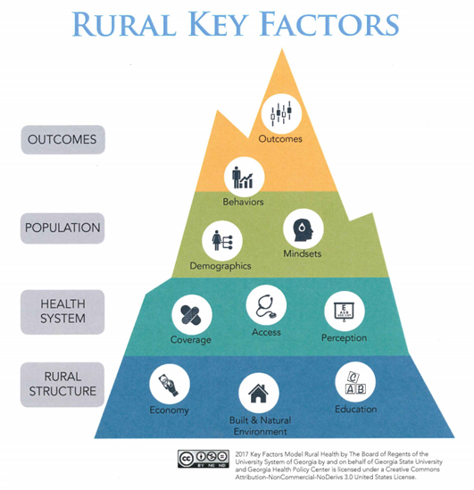
A Pilot to Increase Annual Wellness Visit Completion Rates in Rural Florida
Ashley Austin Johnson, DNP, APRN, AGPCNP-C & Nidhi Sethi, DNP, APRN, FNP-C
Purpose
Methods
Results
Discussion
The purpose of this quality improvement (QI) project was to increase Annual Wellness Visit (AWV) completion rate in a rural primary clinic in central Florida.
Aim: Within 3 months, 10% of the eligible Medicare patients seen each week will complete an AWV.
The QI pilot was conducted using a PDSA cycle.
Setting
A rural practice in a medically underserved area in Central Florida participated in the pilot
3 physicians, 1 nurse practitioner (NP), 1 office manager, and 6 staff.
An unduplicated panel of 47,000 patients (includes consultations and hospital patients)
65-70% of patients estimated to be 65 years of age or older
Target Population
Patients ages 65 years or older, eligible for an AWV
PLAN
Pilot coordinators completed a needs assessment, observed office workflow, and set mutual goals
Developed new office processes, workflow, needed forms and templates based on CMS guidelines
DO
The 10-week pilot was initiated January, 2019
Pilot implemented and real-time adjustments made to AWV forms per practice feedback including addition of a summary document
Patient education handouts provided
A community resource guide was created to identify available community services (e.g. pharmacies, transportation, food pantries and faith-based resources)
Connected practice to the Counsel on Aging for additional support in meeting patient needs
STUDY
A total of 384 Medicare eligible patients were screened and offered the AWV.
47 patients were scheduled and completed an AWV
337 patients did not schedule an AWV
AWVs provide a means to promote wellness in older adults and are reasonably easy to integrate. They also provide an untapped source of income to support rural practice sustainability in areas of high need.
Limitations
Minimal literature available regarding best practices to improve AWV completion rates in rural areas; only low level evidence in non-rural areas
Lack of an optimized EHR to support quality indicator tracking and patient recall
Staff turnover
Competing priorities
Pilot results may be transferrable but not generalizable to all rural practices
Recommendations
Increase patient awareness of AWV via brochures, signs, and pamphlets in high traffic areas
Encourage tracking of related quality indicators for MIPS/ MACRA reporting to support eligibility for CMS reimbursement incentives
Expand availability of AWV patient forms in multiple languages
Explore EHR compatibilities with the vendor to support QI dashboard operability and patient recall
Conduct a subsequent PDSA cycle to evaluate effectiveness of AWV completion by a licensed nurse (without advanced care planning)
Background
Health disparity risk factors in rural areas include low socioeconomic status, geographic remoteness, lack of quality healthcare, and higher rates of chronic health conditions.
The Center for Medicare and Medicaid Services (CMS) Rural Health Strategy objectives include application of a rural lens to CMS programs and policies and efforts to improve access to care through provider engagement and support.
AWV is a free Medicare benefit and provides preventative services. Yet completion rates remain low nation-wide (~25%), especially in underserved areas (~10%).
The Key Factors Influencing Rural Health Framework (2017) was utilized in the pilot to optimize rural relevance. The framework outlines factors influencing health outcomes in rural settings.
Figure 2. Number of AWV completed each week
Patient feedback and reasons for declining the AWV:
Negative:
Lack of knowledge regarding insurance coverage
Scheduling conflicts
Practice provider not available
Lack of interest
Acute illness
Positive:
Enjoyed the review of family history and medication education
Staff feedback:
Time consuming to prescreen charts
Patients more willing to complete screenings
ACT
Within 10 weeks, a 12.2% increase in completion rates for those eligible occurred, exceeding the expected goal in a shorter time frame
Estimated reimbursement for the 10-week period was $5,170 - $7,802; corresponds to a projected annual ROI of $26,684 - $40,570
The dip in completion rates from week 4 to 6 likely represented an increase in sick visits due to respiratory illnesses in the community
Office manager identifies eligible patients prior to appointments
NP/physician reviews data and updates plan of care
Upon arrival, patients fills in AWV forms
Office manager complete billing
Next year’s AWV is scheduled
References
References available upon request.
Acknowledgments
Thank you to Dr. Brittany Hay for your guidance and support during this project.
Thank you to the partnering site for allowing us to implement and help bring the AWV to the practice.
Thank you to the numerous USF College of Nursing faculty that encouraged and provided guidance through the DNP program and project courses.
Review of literature revealed several strategies to support AWV completion in primary care:
Staff education and patient introduction to AWV
Interdisciplinary approaches and integration of AWV documentation into the electronic health record (EHR)
Figure 1. Practice workflow
Notes:
1

