Slide 1
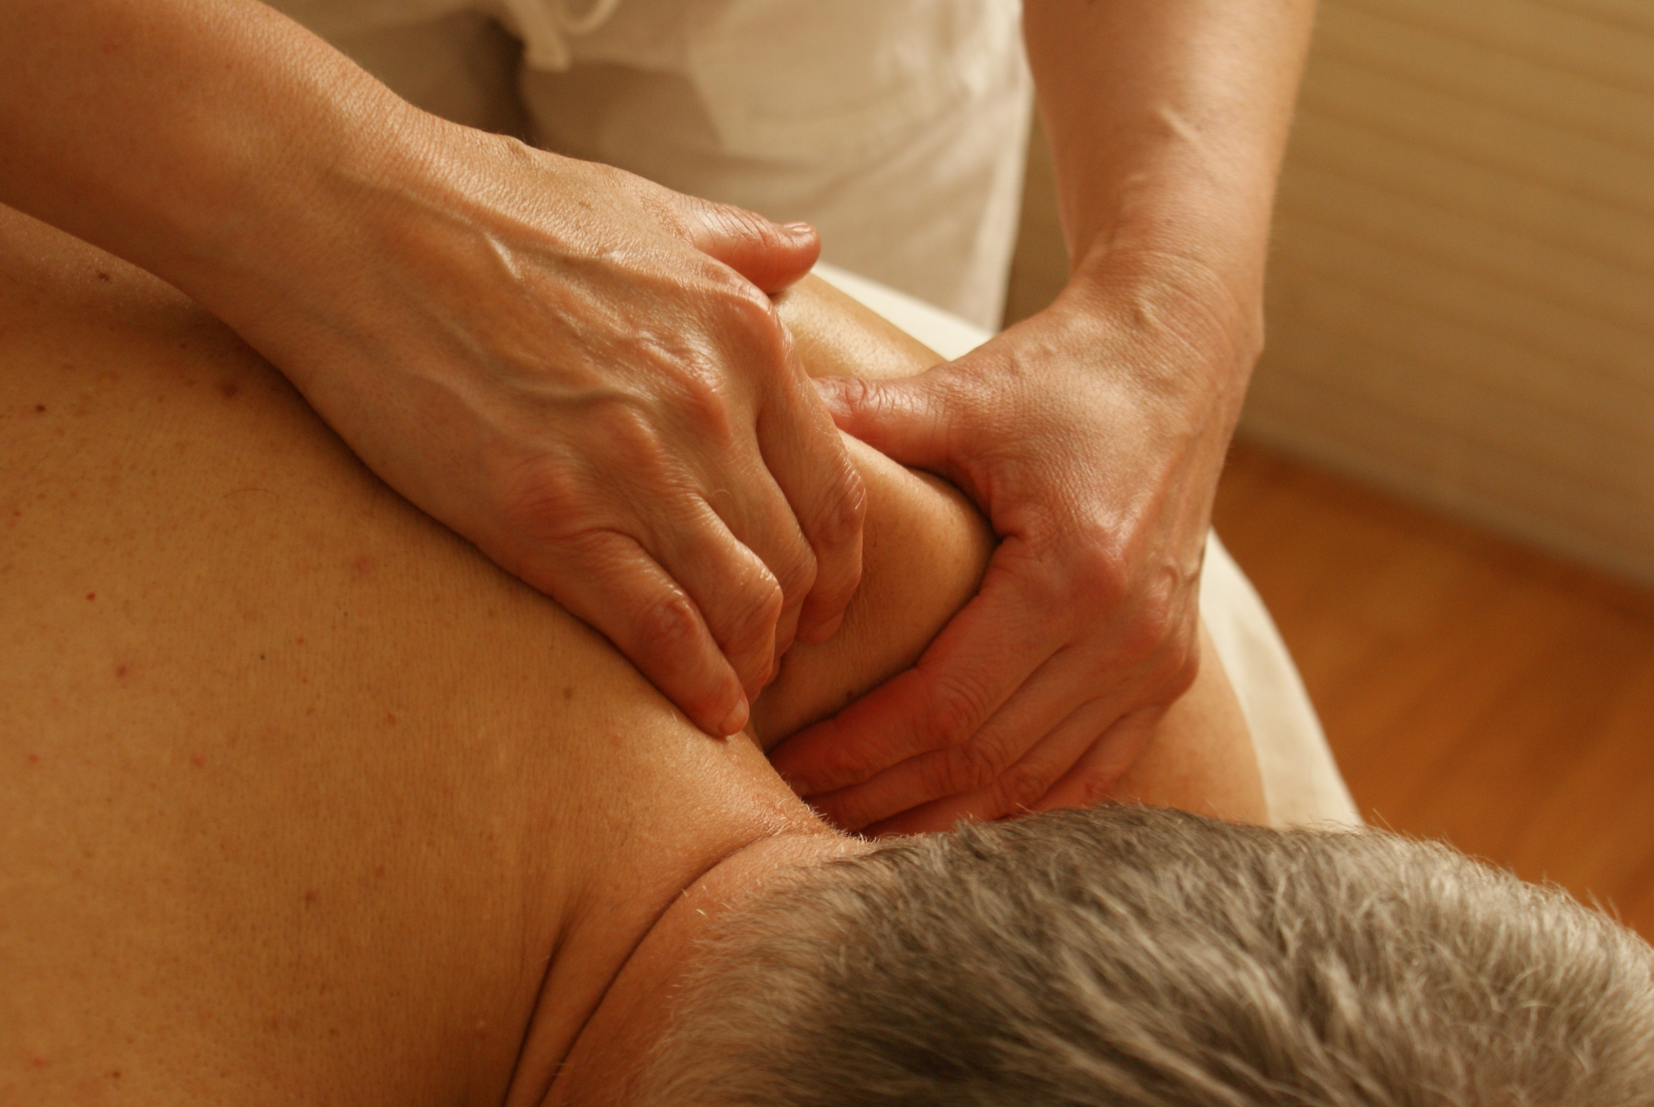
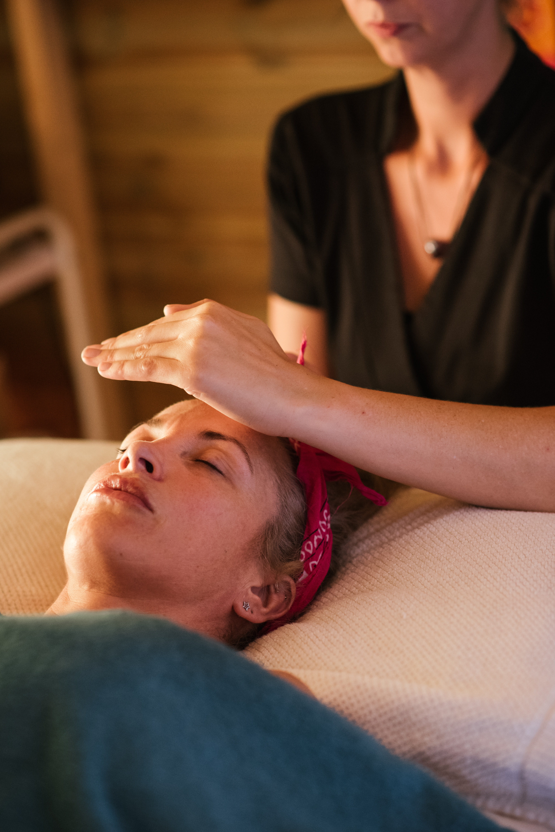
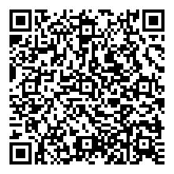
COMPLEMENTARY ALTERNATIVE MEDICINE FOR PAIN MANGEMENT
Jessy S. Abraham, DNP, APRN, FNP-BC
Project Faculty: Dr. Jacqueline Gordon, DNP, APRN, CCNS, CCRN-K
PROBLEM STATEMENT
Chronic pain is a common public health problem, an estimated 19.6 million people over the age of 65 suffer from chronic pain (Center for Disease Control, 2018).
$560 billion is spent annually to manage pain, 85% of the geriatric population use conventional medicine for pain management (Center for Disease Control, 2018).
Complementary Alternative Medicine (CAM) is an effective non-pharmacological approach for pain management and greatly reduces health care costs (HHS, 2019).
PROJECT PURPOSE
Purpose: To develop and implement a standardized evidence-based CAM treatment protocol inclusive of reiki, music, massage, and acupuncture to reduce pain in patients with chronic pain in a geriatric outpatient clinic.
Clinical Question: Does the addition of reiki and standardization of the current CAM protocol decrease pain intensity in geriatric patients with chronic pain compared to current practice within three months?
MODEL/NURSING THEORY
John Hopkins Nursing Evidence-Based Practice model (JHNEBP).
Neuman’s System Model nursing theory.
METHODS
Participants: Geriatric patients ages 65-89, receiving pain management at the geriatric clinic.
Setting: All-Inclusive senior care clinic located in the Tampa Bay area.
Exclusion Criteria: Contraindications to reiki, acupuncture and massage and patients who do not agree to participate or are cognitively impaired
Instruments/Tools: Numeric Rating Scale (NRS) a valid reliable 11-point scale.
INTERVENTION/DATA COLLECTION
Demographic characteristics and NRS pain scores before and after CAM treatment session were collected.
Data were collected over a three- month period.
All data were transferred to an Excel spreadsheet at completion of the data collection period for analysis.
Results
DISCUSSION
Participant Demographic Characteristic Valueª
Age (year): Mean 72.5 Range 65-87 Gender: Female 23 (67.6) Male 11 (32.3) Race: White Caucasian 31 (91.2) African American 2 (5.8) Asian 1 (2.9) Duration(year): Mean 11.2 Range 0.5-50
Demographic characteristic of total population (N)=34 Valueª is number (percentage) unless otherwise indicated in the first column..
Combination music, massage, acupuncture and reiki therapies are effective non-pharmacological alternatives to manage.
This project provides further evidence that combination CAM treatments are effective for pain management in the geriatric population.
Limitations: CAM protocol limited to one treatment session, additional treatment sessions over a longer period must be evaluated.
IMPLICATIONS FOR ADVANCED PRACTICE NURSING
COMPLEMENTARY & ALTERNATIVE TREATMENT PROTOCOL
Reiki: Healing touch therapy for 15 minutes
Acupuncture: Needle acupuncture provided
Massage: Trigger point massage and regular massage provided for 15-30 minutes
Assess post-CAM treatment NRS score.
Music: Selected based on patient preference
Assess pre-CAM treatment NRS score
Health providers treating geriatric patients should consider adding CAM treatments as an alternative to pharmacologic therapy to manage patients’ chronic pain.
Advanced Practice Registered Nurses (APRNs) implementing CAM treatments in their practice settings can impact the rising costs of pharmacologic pain management in the geriatric population.
SUSTAINABILITY
Leadership at project site supportive of this project
The APRN practicing at the project site is certified in CAM treatments and will implement this practice with all patients suffering from chronic pain.
The total number of patients were 37, 34 received CAM treatments, 3 patients stated that they did not want to participate.
Standardized CAM treatment protocol led to statistically significant reduction in NRS pain scores in patients with chronic pain, mean difference in pre-and post-scores demonstrated a decrease from 6.76 to 2.38 = 4.382 (p<.001).
References
Implementation of a CAM treatment protocol demonstrates a statistically significant
reduction in pain for geriatric patients with chronic pain.
Notes:
Use Arial font
For text boxes: Do not drop below font size 28, but if you have extra space, you can up the font size until the space is full.
You can move around and customize the template to best fit your information.
Create a QR Code here: https://www.qrcode-monkey.com/ or here: https://www.qr-code-generator.com/

