Slide 1
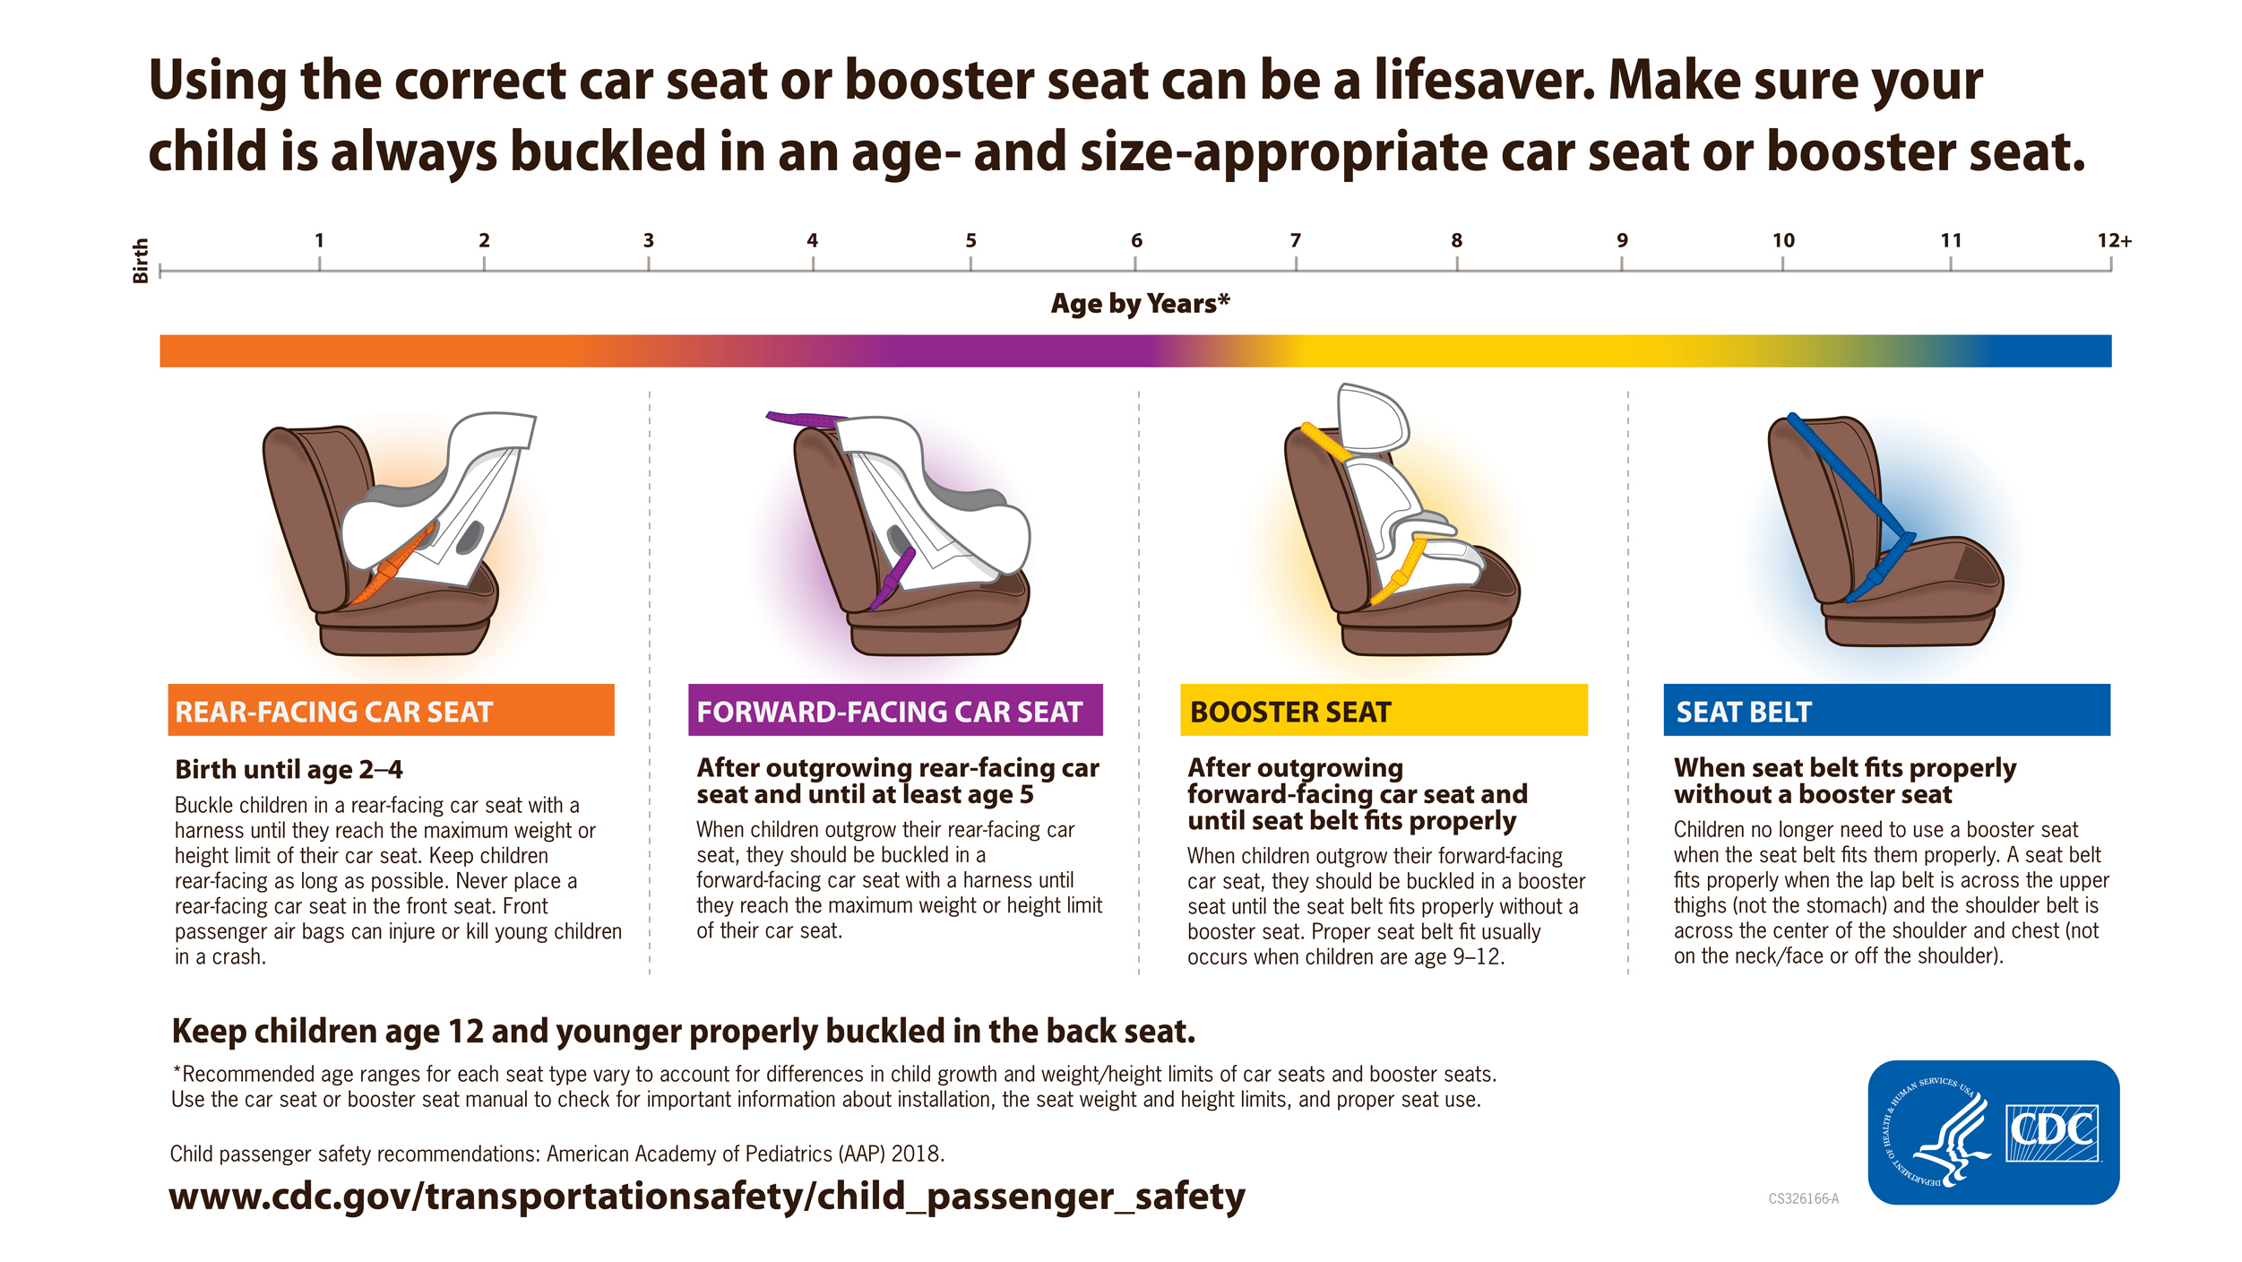


A Standardized Approach to Child Passenger Safety Screening in the Emergency Department
Heidi Almodovar, DNP, APRN, CPNP-AC/PC, TCRN
Project Faculty: Christina Cardy, DNP, APRN. AGACNP-BC
PROBLEM STATEMENT
Motor vehicle collisions (MVCs) are a leading cause of death and injury in children¹
FL children ages 5-24 years die from MVCs >any other cause; 2nd cause of death in children 0-4 years²
53% of underserved children in catchment area unrestrained or improperly restrained³
INTERVENTION/DATA COLLECTION
RESULTS
PLAN- Fall 2021
Needs assessment, review of literature, SWOT analysis
Stakeholder engagement
IT/Marketing engagement
Cost-benefit analysis
IRB Approval
5,225 eligible participants March-May 2022
<12yo, <4’9”
PROJECT PURPOSE
Standardize child passenger safety (CPS) screening in Emergency Department (ED)
Aim: increase referrals to the pediatric injury prevention coalition (PIPC)
In the pediatric population <12 years and <4’9” presenting to an urban pediatric ED, will implementation of a CPS bundle increase referrals to a PIPC over a three-month period?
199 (3.8%)
Families referred representing 230 children
#of referrals
DO- January 2022
CPS bundle
Print, laminate, screening materials
CPS curriculum delivery to residents
Resident physician post-test
5” in-servicing of ED attendings/RNs
Resident screen families
QA chart review
PIPC check for referrals, contact families, in-service, schedule to meet with families
Sources of referral
ED 77%
Other
23%
MODEL/NURSING THEORY
Model for Improvement Plan-Do-Study-Act Cycle⁴
Nola Pender’s Health Promotion Model⁵ –Understanding importance of health promotion and preventative healthcare
2019: x² (1, N=199) = 226.7936, p= <.00001
2021: x² (1, N=199) = 150.1504, p= <.00001
Of 199 referred families,
82 (41%) connected with PIPC representing 110 children
METHODS
Participants: children <12 years, <4’9”, seeking care in ED March-May 2022
Design: Pre-post design
Setting: Nonprofit, academic, tertiary center, 15-bed pediatric ED, large urban area,
DISCUSSION
We found a standardized approach to CPS screening in this ED increased referral to PIPC and increased distribution of CSS
Development of CPS bundle is effective and easy to implement
Need for reinforcement of significance of problem
Low CPS screening compliance-provider dependents
Potential to positively impact social determinants of health and health inequities
Limitations: data collection method, resources, Covid/QI burnout, Resident physician rotating schedules and resistance
IMPLICATIONS FOR ADVANCE PRACTICE NURSING
Implementation of the CPS bundle successfully addressed a need in the community and had a positive impact on population health
This project addressed social determinants of health and health inequities by increasing access to a life-saving resource and has the potential to prevent death and injury in the vulnerable pediatric population.
A CPS bundle incorporated informatics and health care technology
SUSTAINABILITY
QI attending physician champion
Badge buddy
Uploaded to “The Hub”
3-minute CPS in-service video
DNP project garnered attention from hospital leadership-plan to disseminate throughout health organization-to be championed by nursing
STUDY- March to May 2022
Document # of referrals/ # of children
Chart review-screening compliance
Calculate % of families established contact with PIPC
Track source of referral
Track seat type distributed
Document demographic info
Analyze resident post-CPS curriculum scores
No child safety seats distributed to 59% of the other referred families because:
INSTRUMENTS/TOOLS
CDC best practice guidelines⁶
No answer/ message left
17%
No show for screening 19%
Wrong # 14%
Elected for self-directed behavior change 9%
Child safety seats distributed to 110 children
ACT- March 2022-ongoing
Weekly QA/QI
Resident re-orientation
Upload screening tool to “The Hub”
Spanish/ Creole translation: d/c teaching tool
Leadership engagement to take project system wide
Badge buddy
3-minute CPS screening in-service video
Car seat
94=85%
Booster seat
9=8%
Seat check
2=2%
Not yet distributed
5=5%
CONCLUSION:
A standardized approach to child passenger safety screening in the emergency department increased referrals to a pediatric injury prevention coalition and improved education and access to child safety seats.
References:

