Slide 1
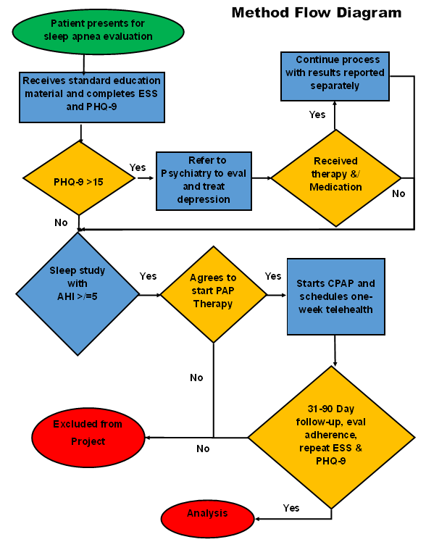
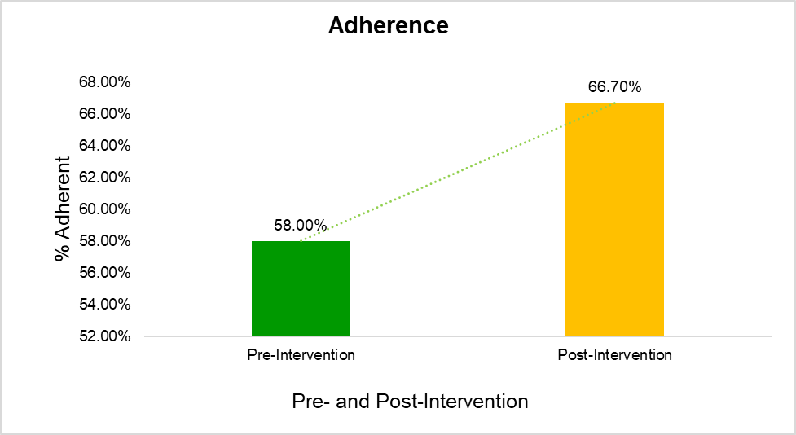
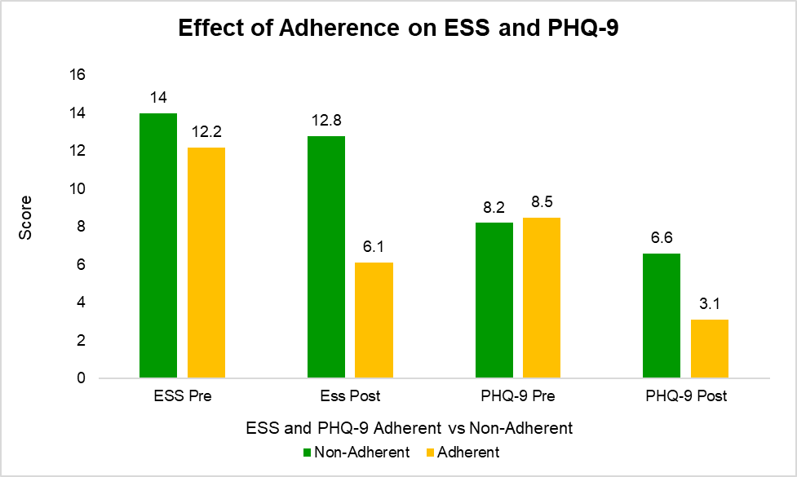
Improving Continuous Positive Airway Pressure Therapy Adherence Through Early Telemedicine Follow-up
Joseph Ashmore, DNP, APRN, FNP-C
Jacqueline Gordon, DNP, APRN, CCNS, CCRN-K
Problem Statement
Methods
Results
Discussion
Excessive daytime sleepiness (EDS) and depression are known consequences of obstructive sleep apnea (OSA) (Jackson et al., 2019).
Telemedicine (TM) has been shown to improve adherence (Chen et al., 2020).
EDS and depression are improved when patients are treated with and adherent to positive air pressure (PAP) most commonly continuous positive airway pressure (CPAP) (Jackson et al., 2020).
CPAP adherence in the project setting was 56.25%.
The aim of this quality improvement (QI) project is to improve CPAP adherence resulting in improved EDS and depression. To accomplish this NP delivered pre-PAP education was designed and delivered across the project and a one-week post-PAP initiation follow up TM visit was implemented.
In adult patients newly diagnosed with sleep apnea does standardized pre-PAP instruction and a TM visit one week after initiation of PAP increase adherence and result in improvement in depression and daytime sleepiness over three months compared to current practice?
Orem’s Self-care Deficit Theory of Nursing
The IHI Model for Improvement
Setting: Academic medical sleep center
Participants | Inclusion: Age 18-89, Positive Sleep Study(AHI >/= 5), accept CPAP treatment Exclusion: Negative sleep study (AHI <5), declined CPAP treatment
Measures | ESS PHQ-9
Intervention | NP delivered OSA/CPAP Education One week TM Follow-up
Data Collection | CPAP start date, Date of TM Visit, Smart card data, Pre/Post ESS, and PHQ-9
NP delivered pre-PAP education and a TM visit one week after receiving CPAP equipment resulted in an increase in CPAP adherence in adult patients newly diagnosed with OSA.
ESS and PHQ-9 decreased in patients adherent to CPAP therapy and mildly in non-adherent patients, suggesting even minimal use of CPAP had some benefit.
The facility chart review (August to October, 2021) demonstrated 33% lost to follow-up. To date there have been no patients lost to follow-up suggesting that the intervention has a significant impact on this key metric.
Adherence | Increased by 8.7% (p=0.5235, 95% CI [17.84, 29.23])
ESS | Adherent decreased by 6.1 (50.0%) (p=0.0004, 95% CI [3.546, 8.654]) Non-Adherent decreased by 1.2 (8.57%) (p=0.1080, 95% CI [-0.41, 2.81])
PHQ-9 | Adherent decreased by 5.4 (63.53%) (p<0.001, 95% CI [3.96, 6.824]) Non-Adherent decreased by 1.6 (19.51%) (p=0.782, 95% CI [-0.287, -3.487])
Project Purpose
Limitations
COVID-19
Lost to follow-up
CPAP Recall
Supply Chain Issues
Implications for Advance Practice Nursing
The use of TM along with NP delivered educational content is effective in improving CPAP adherence, EDS and depression in patients with OSA and started on CPAP and reduces the number of patients lost to follow-up.
PICO(T) Question
Sustainability
The data garnered from this project supports the facility's plan to budget for a NP FTE to manage patients newly diagnosed with OSA and partner with select vendors to facilitate wireless collection of CPAP adherence data.
Model/Nursing Theory
References
NP delivered education and a telemedicine follow-up one week after CPAP initiation increases adherence and decreases daytime sleepiness and depression.

