Slide 1
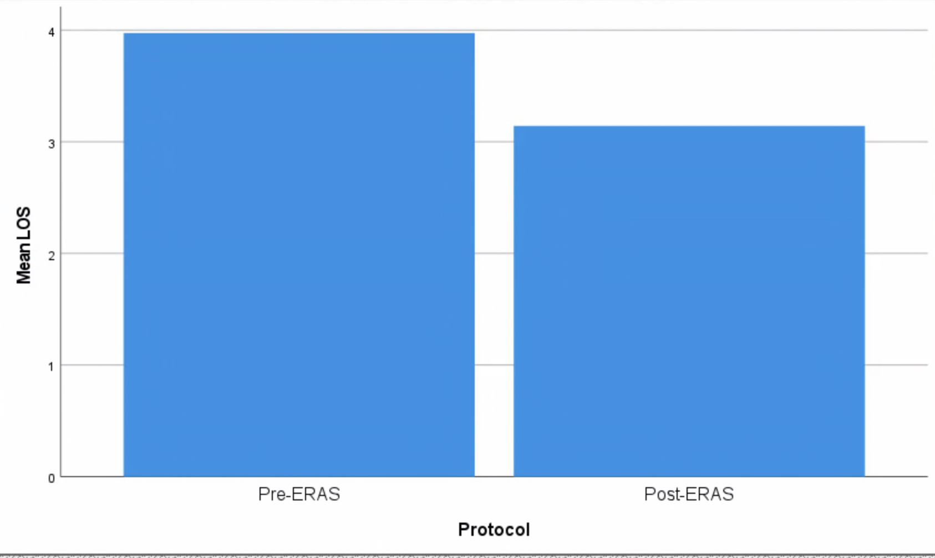
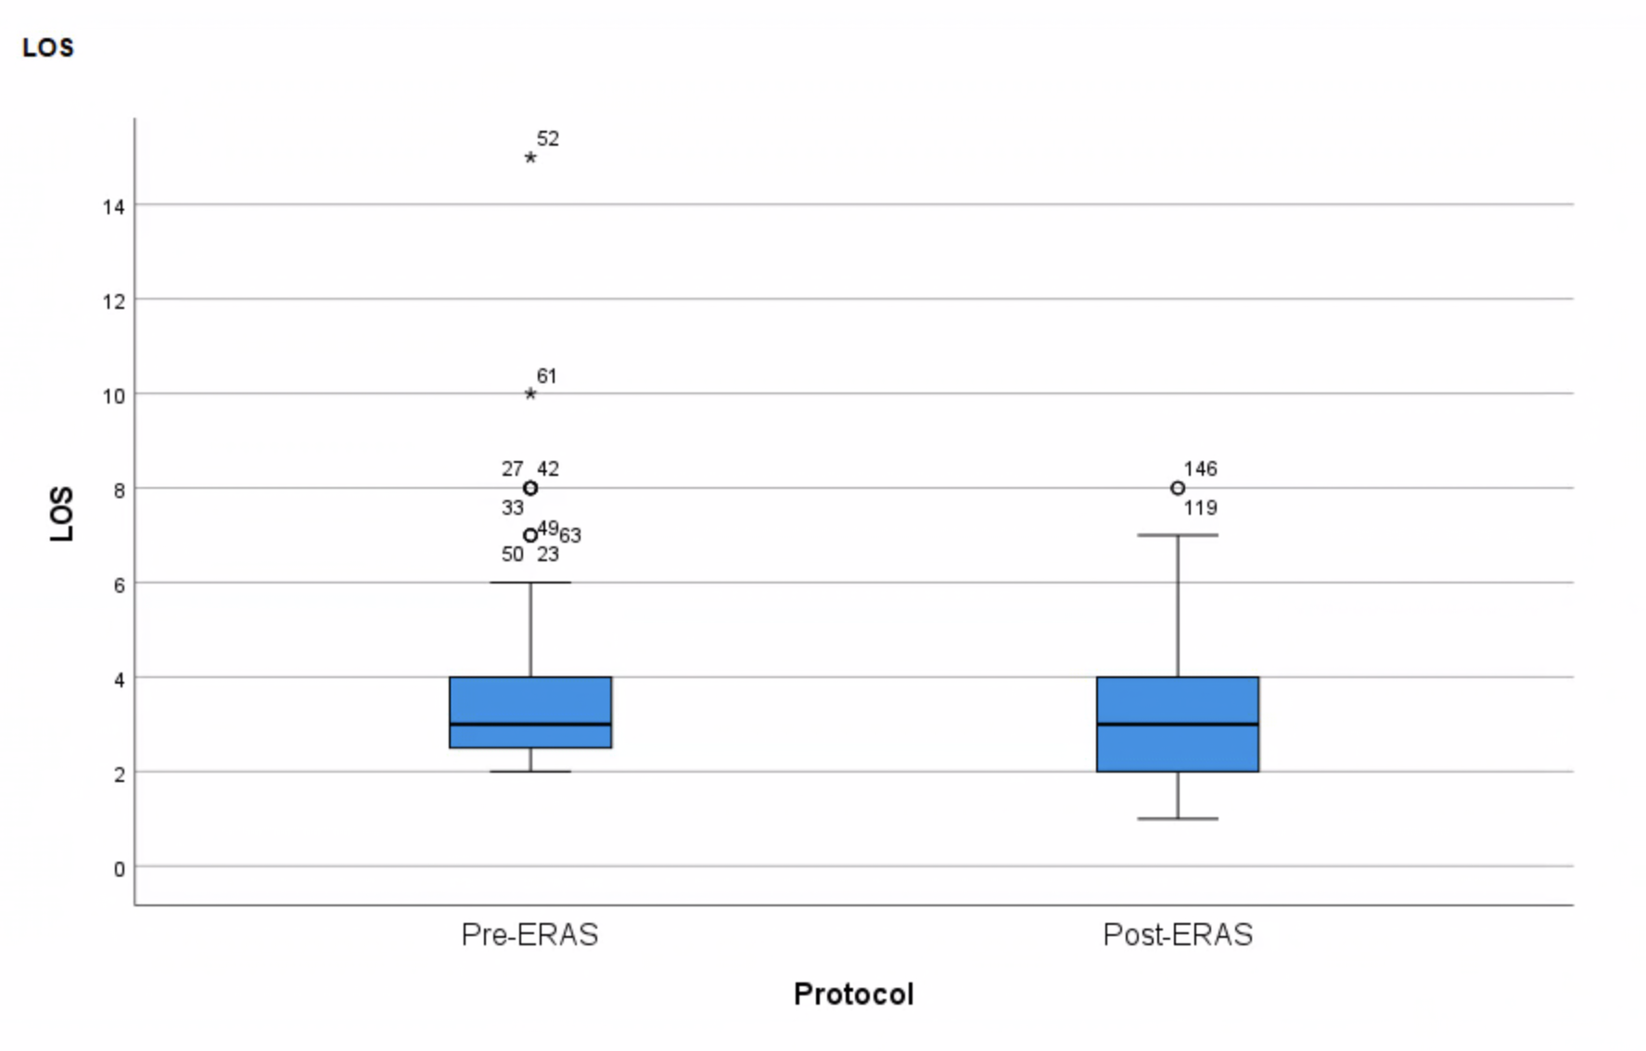
Improving Length of Stay in Veterans Undergoing Total Joint Arthroplasty Martha Beach, DNP, APRN,CCNS-BC, ACNP-BC
Project Faculty: Christina Cardy, DNP, APRN, AGACNP-BC
PROBLEM STATEMENT
Patients who underwent elective total knee or hip arthroplasty at a local Veterans Health Administration (VHA) hospital consistently experienced a higher hospital length of stay (LOS) when compared to the national average of similar surgeries due to factors such as lack preoperative optimization, lack of early ambulation, poor pain control and delayed oral intake
Failure to address preoperative optimization, poor postoperative pain control, lack of early mobilization and initiation of early oral intake contribute to longer hospital length of stay
Extended hospital LOS increases the risk of post-operative complications
PROJECT PURPOSE
To decrease hospital length of stay in patients undergoing elective joint arthroplasty through the implementation of an ERAS protocol.
Comparison implementing a perioperative ERAS protocol for total knee or hip arthroplasty at decreasing LOS to current traditional care
Clinical Question: In veterans undergoing total joint arthroplasty at a Veterans Affairs (VA) hospital, does implementation of an Enhanced Recovery After Surgery (ERAS) guided perioperative protocol decrease length of hospital stay when compared to current practice over a three-month period?
METHODS
Participants
Military veterans undergoing electively scheduled total joint (knee or hip) arthroplasty
Exclusion criteria: Veteran patients undergoing revision surgery for total knee/hip arthroplasty and/or admitted patients requiring emergency/urgent total joint arthroplasty
Setting
A tertiary VHA West Central Florida hospital providing orthopedic surgery with to include Orthopedic Outpatient Clinic, ASU, OR, PACU, Surgical ward and Surgical ICU
Instruments/Tools
An ERAS protocol consisting of a perioperative regimen of patient education, medical optimization, opioid-sparing protocol, intraoperative nerve blocks, antibiotic prophylaxis, POD 0 mobilization from nursing and physical therapy, early oral intake and a standardized order set. (See reference for protocol).
Intervention and Data Collection
Hospital LOS was measured after ERAS protocol implementation
LOS was measured by subtracting the admission date from the discharge date utilizing the Sequel quality reporting program and National Surgery Office (NSO)
Retrospective chart review consisting of aggregated data of electively admitted veterans undergoing total knee/hip arthroplasty for three months prior to implementation of ERAS protocol
Prospective chart review consisting of LOS data of all veterans undergoing total knee/hip arthroplasty for three months after implementation of ERAS protocol
A perioperative ERAS consisting of patient education, medical optimization, opioid-sparing protocol, use intraoperative nerve blocks, antibiotic prophylaxis, POD 0 mobilization, early oral intake and standard order set.
RESULTS
Length of Hospital Days Prior to ERAS and After ERAS
Implementation
Length of Hospital Days Prior to ERAS and After ERAS
Implementation
The data was analyzed using an independent samples t-test
and Cohen’s d for effect size.
DISCUSSION
The perioperative ERAS protocol for elective total hip or knee arthroplasty resulted in a statistically significant improvement in hospital length of stay (p=0.011)
This quality improvement project demonstrated a perioperative ERAS protocol is more desirable to standard surgical care
The implementation of the perioperative ERAS protocol revealed an overall reduction in LOS for entire surgery service below the national average for the first time.
Surgical nursing service reported improved patient pain-control among veterans resulting in greater compliance and participation with early ambulation and oral intake
Physical therapy noted veterans were able to participate in earlier ambulation due to improved pain control resulting and greater ambulation distance.
IMPLICATIONS FOR ADVANCED PRACTICE NURSING
APRNs reported decreased requests for extension of post-operative opioids
APRNs in additional surgical service lines intend to implement a perioperative ERAS protocol as a result of the achieved improved LOS
SUSTAINABILITY
Orthopedic surgery service will continue to utilize the ERAS protocol as the standard for all total joint arthroplasty procedures
Permission will be obtained to update service order sets to reflect the perioperative ERAS protocol
Surgery service incorporated utilization of the ERAS protocol as a goal for improved service LOS through continual quarterly monitoring
REFERENCES
MODEL/NURSING THEORY
QI model: Model for Improvement
Orem’s Self-Care Deficit Theory
Veterans embracing deficits to well-being
Perioperative ERAS protocol implementation resulted in statistically significant improvement in length of stay compared to traditional surgical care
Notes:
Use Arial font
For text boxes: Do not drop below font size 28, but if you have extra space, you can up the font size until the space is full.
You can move around and customize the template to best fit your information.
Create a QR Code here: https://www.qrcode-monkey.com/ or here: https://www.qr-code-generator.com/

