Slide 1
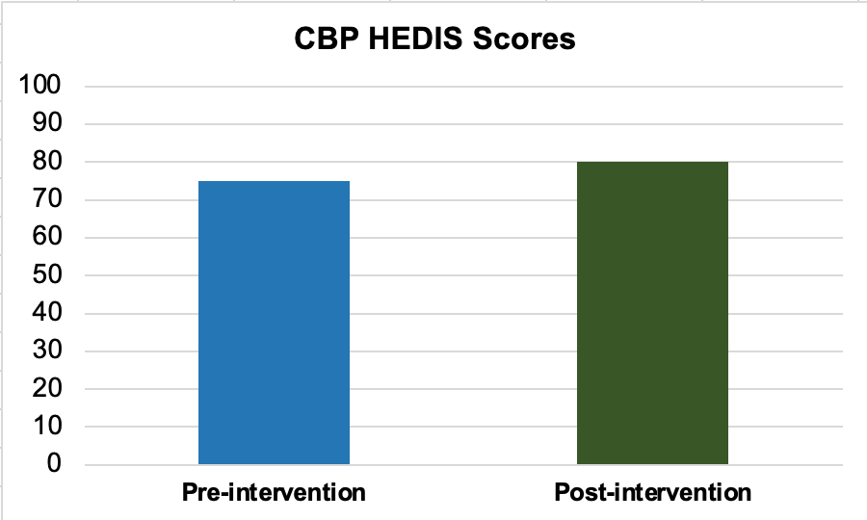
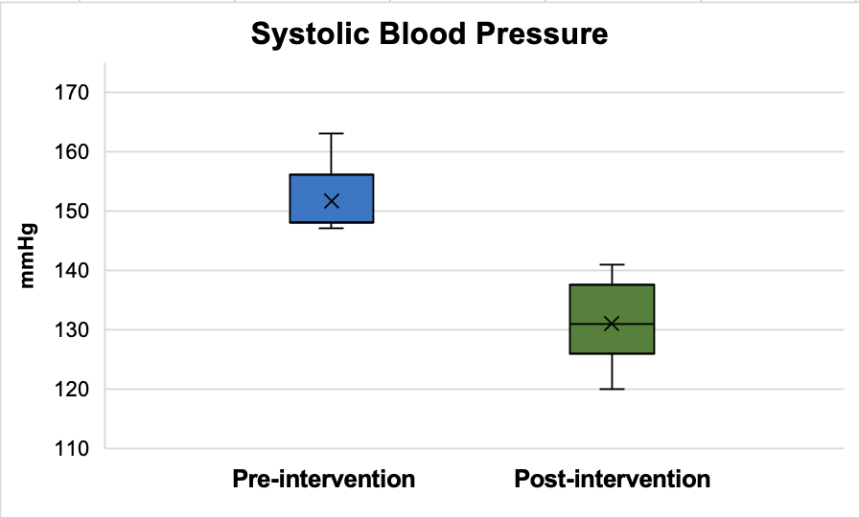
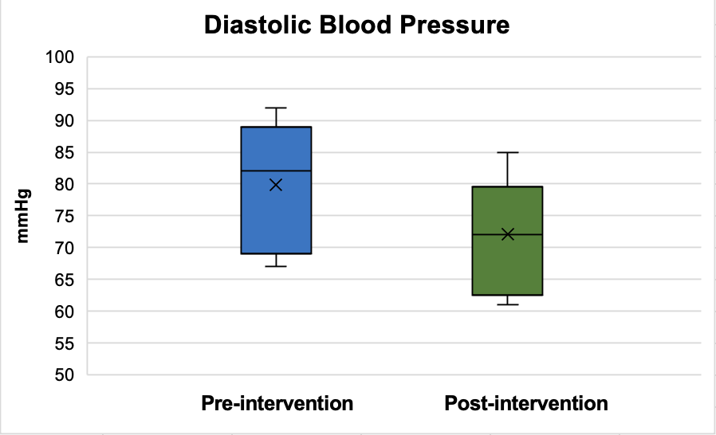
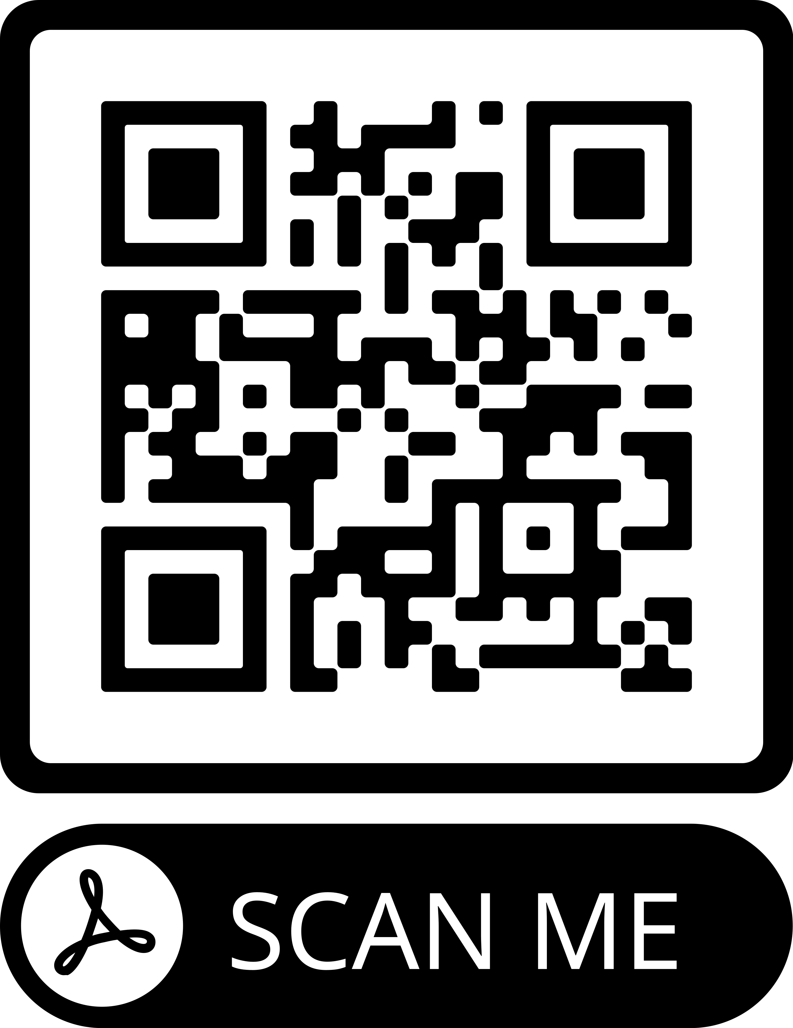
A Team-based Approach to Optimize Hypertension Management in
Older Adults Within Primary Care Judith Buono, DNP, APRN, FNP-BC
Dr. Brittany Hay, DNP, APRN, ANP-BC, FNP-BC
PROBLEM STATEMENT
Hypertension (HTN) impacts approximately 1.4 billion people worldwide and continues to be under recognized and poorly controlled (van Kleef et al., 2017).
Prevalence increases with older age making it an important population health goal (Bowling et al., 2021).
A primary care clinic in Southwest Florida was below goal (<84%) in the controlling blood pressure (CBP) Healthcare Effectiveness Data and Information Set (HEDIS) measure
PROJECT PURPOSE
Purpose: Implement a HTN management protocol to improve clinic processes and BP to support achievement of optimal CBP HEDIS scores
Aim: To achieve CBP HEDIS scores of 80% or more within 90 days of implementing an improved workflow process
Clinical Question: Will implementation of a team-based HTN management protocol in adults aged 65 years and older with uncontrolled HTN improve BP control and related HEDIS measures compared to current practice in a suburban primary care clinic within 90-days?
MODEL/NURSING THEORY
This quality improvement (QI) project followed the Plan-Do-Study-Act (PDSA) Cycle (Deming, 2018).
Based on the Health Promotion Model designed by Nola Pender
Focuses on health-promoting behaviors that encompasses activities towards enhancing an individual’s well-being (Pender, 2011).
METHODS
Subjects (Participants)
Older adults aged 65 years and older with an established diagnosis of essential HTN (n = 13)
Setting
Primary care clinic within Southwest Florida
Exempt from USF IRB oversight
Instruments/Tools
CBP HEDIS measure portrays the percentage of hypertensive adult patients with adequately controlled BP (<140/90)
AHA materials: BP log, heart healthy diet, physical activity recommendations, and steps for accurate BP measurement
Intervention and Data Collection
Conducted a comprehensive needs assessment
Implemented a guideline-based protocol incorporating an interim 2-week telehealth check-in, workflow algorithm, and checklist to support home BP monitoring/behavioral change
30-day enrollment period and protocol implemented over 90 days
Patients were scheduled a 2-week interim telehealth visit and 1-month provider follow-up
Checklist completed by MA/LPN were given to providers for review and patient recommendations
Patients scheduled monthly provider follow-up until BP was at goal or referred to a specialist for management of resistant HTN
Tracked weekly BP data, workflow algorithm adherence, and HEDIS scores
RESULTS
DISCUSSION
The HTN management protocol for older adults simultaneously improved HEDIS scores and BP
HEDIS score increased 6.6%
Mean systolic BP decreased by 21 mmHg
Mean diastolic BP decreased by 8 mmHg
This is impactful as systolic reductions of 10 mmHg are known to decrease CVD-related events by 20%, heart failure by 28%, coronary artery disease by 17%, and stroke by 27% (Ettehad et al., 2016).
This project supports the value of team-based and person-centered strategies to improve BP control
Limitations: COVID-19 pandemic affected participant enrollment and staffing
IMPLICATIONS FOR ADVANCE PRACTICE NURSING
Advanced practice nurses can create and implement guideline-based protocols integrating team-based care and technology to improve health outcomes
Promotes coordinated care to encompass a team-based approach to reduce CVD-related events in hypertensive patients
SUSTAINABILITY
Protocol can be easily incorporated into the clinic’s workflow
Can be translated and replicated at other primary care clinics at low cost
REFERENCES
Pre-intervention 90-day average = 75%;
Post-intervention 90-day average = 80%
Mean systolic BP pre-intervention was 152 mmHg and 131 mmHg post-intervention
Mean diastolic BP pre-intervention was 80 mmHg and 72 mmHg post-intervention
Paired t-test demonstrated statistical significance
Systolic BP decreased by 13.8% [mean = 20.61, SD = 8.67, t(12) = 8.568, 95% CI = 15.37 to 25.85, p <0.001]
Diastolic BP decreased by 10% [mean = 7.69 , SD = 12.61, t(12) = 2.198, 95% CI = 0.066 to 15.31, p = 0.048]
Implementation of a HTN management protocol decreased the mean systolic BP by 21 mmHg and mean diastolic BP by 8 mmHg for older adults in primary care.
Notes:
Use Arial font
For text boxes: Do not drop below font size 28, but if you have extra space, you can up the font size until the space is full.
You can move around and customize the template to best fit your information.
Create a QR Code here: https://www.qrcode-monkey.com/ or here: https://www.qr-code-generator.com/

