Slide 1
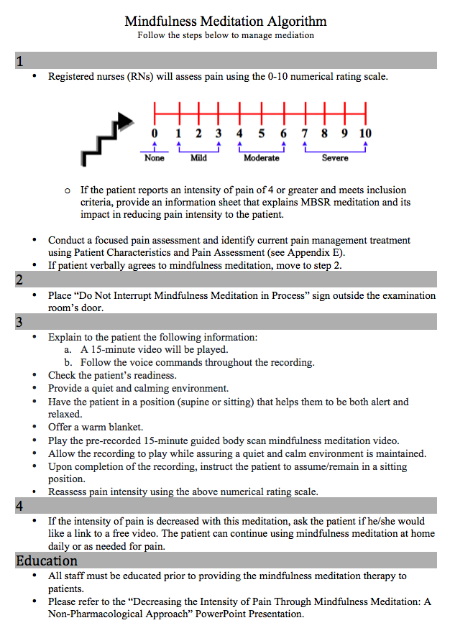
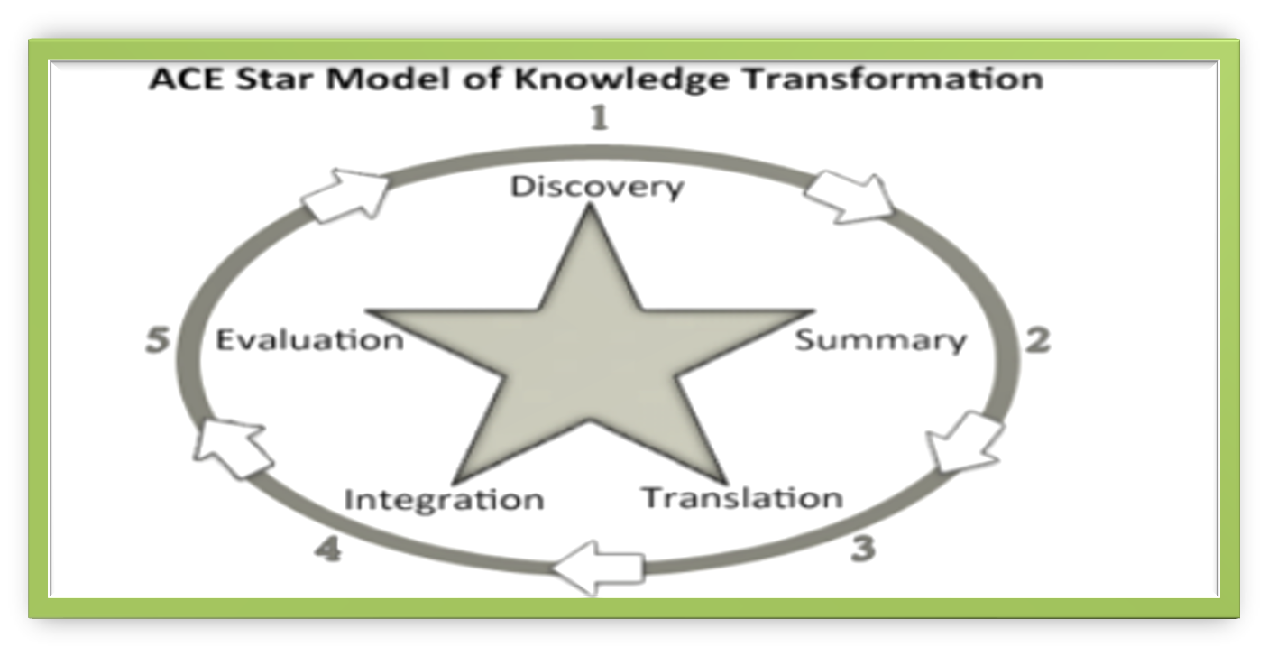
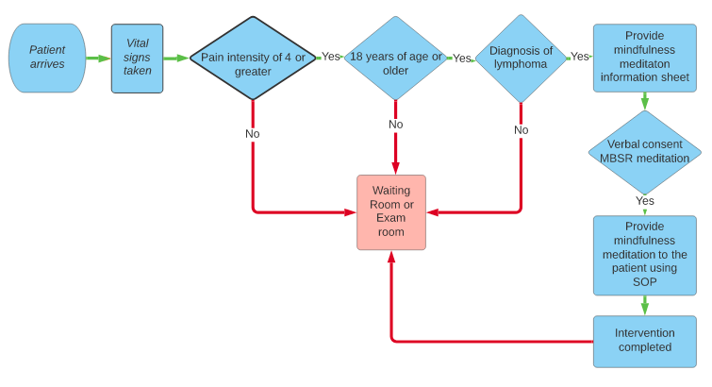
Decreasing the Intensity of Pain through Mindfulness-Based Stress Reduction Meditation: A Non-Pharmacological Approach
Maria Cervantes, DNP, APRN, AGPCNP-BC
Project Faculty: Dorothie Durosier Mertilus, DNP, APRN, AGNP-C
PROBLEM STATEMENT
Inclusion criteria:
Individuals 18 years of age or older
Diagnosis of lymphoma
Exclusion criterion:
Patients with dementia or altered mental status
A malignant hematology outpatient clinic, located in Central Florida
RESULTS
DISCUSSION
METHODS
The following mindfulness meditation algorithm was developed as part of the Standard Operation Procedure: Mindfulness Meditation Protocol.
At a malignant hematology clinic in Central Florida:
Approximately 20% of patients reported pain
70% of these patients suffered from moderate-to-severe pain
81% of them reported no change in pain from previous visits
Pain involves physical, psychological, and emotional states (Fathi & Akhlaghifard, 2019).
Approaches to cancer pain management:
Multimodal approach of opioids
Adjuvant medications
Complementary therapies (Scarborough & Smith, 2018)
Mindfulness meditation, a psychological non-pharmacological intervention, has shown to decrease pain during and after cancer treatment (Jara et al., 2018).
To decrease the intensity of present pain in hematology oncology patients through the implementation of mindfulness meditation therapy
The overarching goal is to improve patients’ pain.
PICOT question: Does the implementation of a mindfulness-based stress reduction meditation decrease pain intensity in hematology oncology patients with moderate-to-severe pain, within a three-month period, compared to current practice?
Statistically significant effect in decreasing pain in breast cancer patients (p < .002) (Johannsen et al., 2016)
Potentially reduce pain catastrophizing and enhance overall well-being in hematology oncology patients (Hess, 2018)
Improves chronic pain, depression, and anxiety in cancer patients (Hilton et al., 2017; Johannsen et al., 2016; Kubo et al., 2019; Ngamkham et al., 2019)
Safely decrease pain severity in cancer patients treated with opioids (Zgierska et al., 2016)
Short-term—10-minute body scan meditation—successful in decreasing pain-related distress and perception of pain (p < .005, p < .036) (Ussher et al.,2014)
A single 15-minute session of scripted MBSR meditation significantly decreased the intensity of pain (Garland et al., 2017)
SETTING
LIMITATIONS
PROJECT PURPOSE
No long-term follow-up (Garland, 2017)
Lack of caregiver participation
Patients believe/culture
IMPLICATIONS
May decrease risk of polypharmacy (Tkatch et al., 2018)
Effective for treating acute or chronic pain (Hilton et al., 2017; Jara et al., 2018; Ngamkham et al., 2019)
Cost-effective adjunct therapy
Can be used as a self-management tool (Kumar et al., 2020)
SUSTAINABILITY
MODEL/NURSING THEORY
Variable: Intensity of pain reported by patients before and after the intervention
Instrument: The Numeric Rating Scale (NRS) is a validated tool used to measure pain intensity before and after the intervention (Kim & Jung, 2020).
Electronic health records (EHR) will be used to review and obtain participants’ demographics and clinical characteristics as well as current pain management interventions.
Health Insurance Portability and Accountability Act (HIPAA) regulations will be followed throughout the project.
Data will be de-identified by assigning an identification (ID) number to each participant.
Data collection will be completed in a three-month time frame.
Annual mandatory education for nurses
Welcome video in the Get Well Network
Support from Integrative Medicine Service
INSTRUMENT
REFERENCES
INTERVENTION & DATA COLLECTION
Figure 1: ACE Star Model of Knowledge Transformation(Thomas, 2017)
Innovation-Decision Process Nursing Theory
Figure 2: Innovation-Decision Process Nursing Theory ( Shajania et al., 2004)
Mindfulness Meditation Adjunct Therapy: Flow Chart
Mindfulness meditation is an effective non-pharmacology therapy for cancer pain management.

