Slide 1
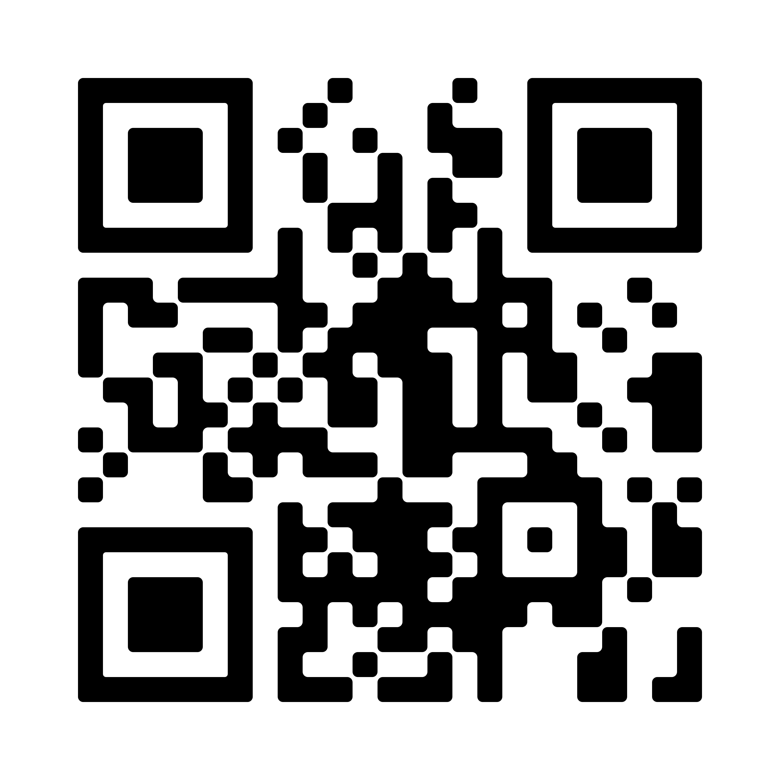
Improving Lipid Management in Adults Who Opt Out of Statin Therapy
Alice Yi Gu, DNP, APRN, AGPCNP-C
PROBLEM STATEMENT
93 million adults, 20 years and older, have total cholesterol (TC) levels higher than 200 mg/dL in the U.S (CDC, 2020). Of those adults, approximately 29 million have TC levels over 240 mg/dL (CDC, 2020). The self-reporting high TC in Florida is about 29.9% to 31.7% in 2017 (CDC, 2020).
Two sets of random chart reviews in selected clinic revealed many patients with elevated LDL (> 100mg/dl) do not meet the criteria for statin therapy or are not in treatment.
Lifestyle changes are the preferred, first-line intervention (Grundy et al., 2019).
PROJECT PURPOSE
This quality improvement (QI) project is designed to implement a non-pharmacological lipid management bundle to help adult patients with elevated cholesterol levels who are not on statin therapy better control their lipid levels.
The bundle includes motivational interviewing meetings and introducing the free physical activity planner and digital dietary app.
Clinical Question: For adult hyperlipidemia patients who are not on statin therapy, will the implementation of a non-pharmacological lipid management bundle help with better adherence to lifestyle modifications and improve the cholesterol levels after 3 months?
METHODS
Participants
Eligible participants were adults (18 years and older, regardless of race or ethnicity) with a LDL level greater than 100 mg/dL who are not on statin therapy.
Setting
Primary care clinic owned by a large healthcare system loccated in central Florida.
RESULTS
A total of 307 patient charts were reviewed during November 2021. Among eligible patients, 41 agreed to join this QI project. Their ages ranged from 22 to 75, with nearly equal numbers of males and females.
Among the 41 participants, only 8 of them answered the call/message after 3 months during the LS7 reevaluation. LS7 scores of these patients remained unchanged (p-value =1 ).
24 participants had repeated lipid panel done as part of routine labs after the intervention,
A majority of the participants (87.7%) were overweight/obese (BMI >25). A total 15 of them had repeated weight on the same scale. The mean value of the weight was the same 199.73lb (P = 1.0000), but 8 of them (53.33%) had a modest weight loss ranging from 1 to 6 lbs.(One female participant self-reported a 15 lbs weight loss but this data point was excluded.)
DISCUSSION
The P values are all larger than 0.05. The result are not statistically significant, but more than half of particpants had clinical reduction of their LDL, TC and weight after interventions.
Although MI participation decreased from 100% in person to 43.9 remotely, results still showed clinical significance, which suggests even one MI meeting may positively change patients' health behaviors.
Final data were collected after the holiday season, which may affect the cholesterol outcome.
Familial hyperlipidemia or some other underlying health issues can also affect the outcome.
LIMITATIONS
Intervention window was probably too short to show the benefit.
The sample size was too small to show statistical significance.
LS7 scoring is based on some general questions which may miss a lot of lifestyles improvement.
LS7 scores were probably inadequate
IMPLICATIONS FOR ADVANCED PRACTICE NURSING
The use of statin can be postponed or prevented, and the patient’s preference to decline pharmacological intervention can be respected.
Other cholesterol-related disease may also benefit from the project.
SUSTAINABILITY
More providers in the primary care seting can become trained and adopt motivational interviewing in their daily practice to promote healthy behavior.
REFERENCES
First MI Interview
Second MI Interview
Instruments/Tools
Lipid Panel
LDL and TC
Weight
Weight loss starting at a 5% decrease is considered clinically meaningful for dyslipidemia patients (Ryan & Yockey, 2017).
Life’s Simple 7 (LS7) is
A lifestyle scoring tool developed by the AHA
all 41 participants had their first MI meeting in person during the first 4 weeks.
18 of them had their second MI interview remotely in weeks 5 and week 6.
100%
43.9%
Intervention and Data Collection
General chart reviewed to identify eligible Patients in the first 4 weeks
Eligible Patients were able to opt in the project.
Once they opted in, the first motivational interviewing (MI) meetings were started immediately by the DNP student who has MI training
LDL↓↓↓
The LDL dropped from 135.50 mg/dl to 131.46mg/dl (P = 0.4571), among these 24 patients 58.33% had decreased LDL after 3 months.
The printed information about Move Your Way Activity Planner and the Start Simple with MyPlate mobile application was provided.
The TC dropped from 218.58mg/dl to 215.75mg/dl (P = 0.6551), and 54.16% of them showed improvement.
TC
↓↓↓
Second MI meetings were offered remotely in week 5 and week 6
all components of bundle were implemented in 6-week window
MODEL/NURSING THEORY
Plan-Do-Study-Act (PDSA) model
The framework to design in this QI project process
The Transtheoretical Model
It explains how patients may transition to healthier behaviors (Raihan & Cogburn, 2021).
LDL level, TC level and weight were documented before initial MI encounter and also again after 3 months.
LS7 scores will be calculated before the first MI meeting and again after three months.
Implementation of non-pharmacological lipid management bundle did not show statistically significant reductions in participants’ cholestertol levels

