Slide 1
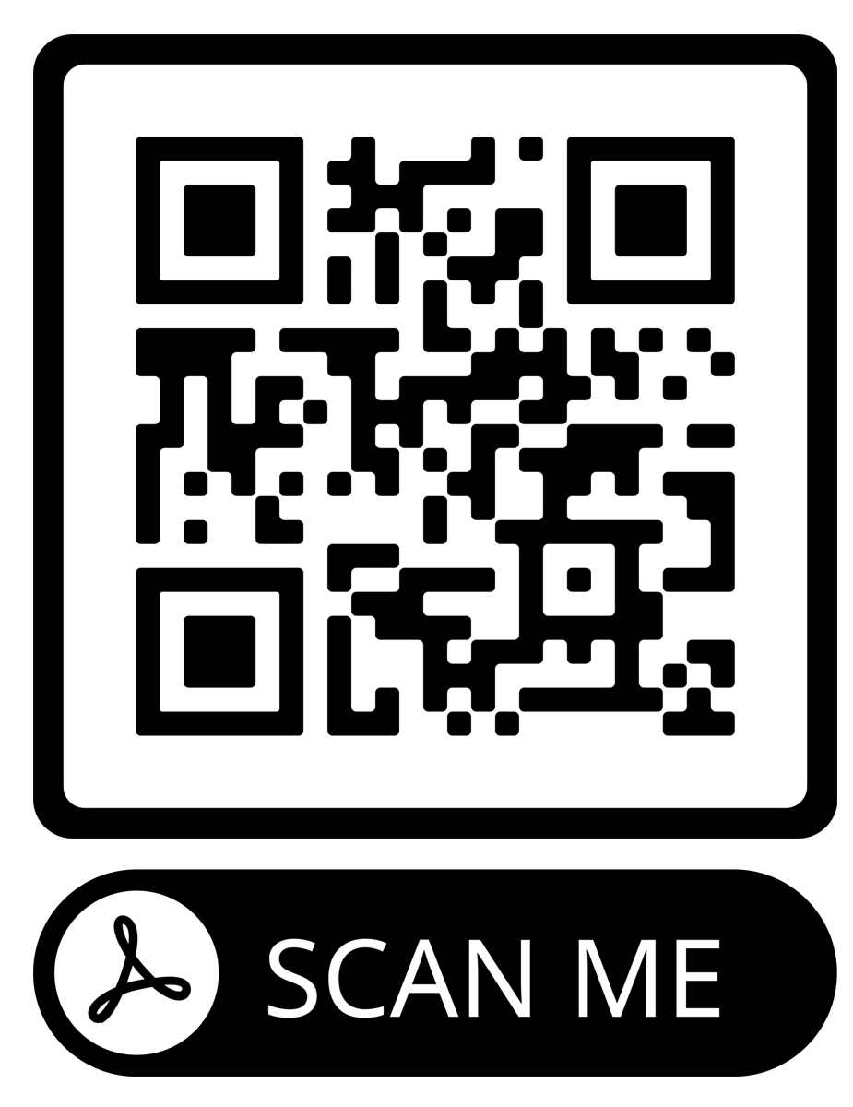
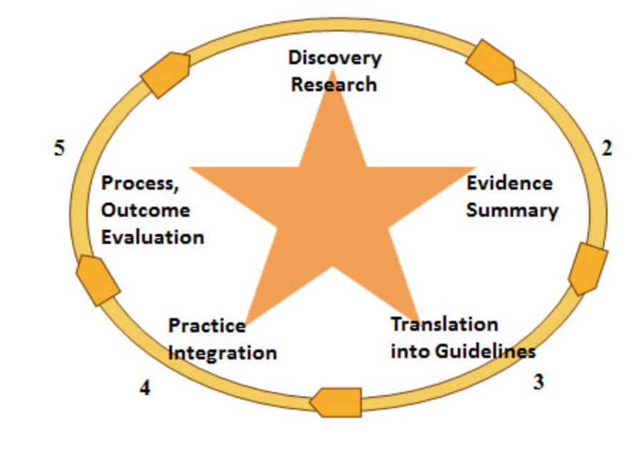
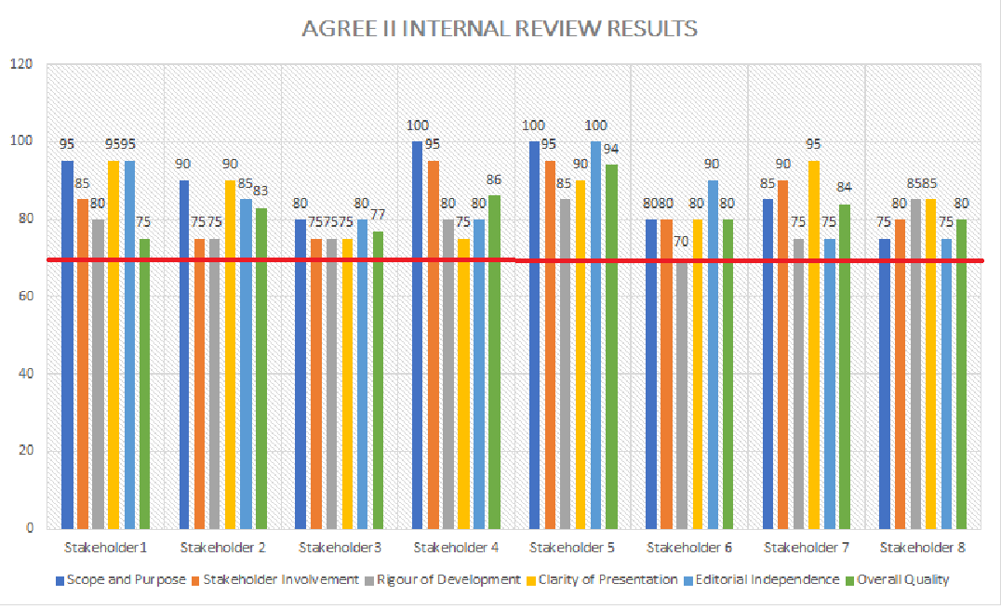
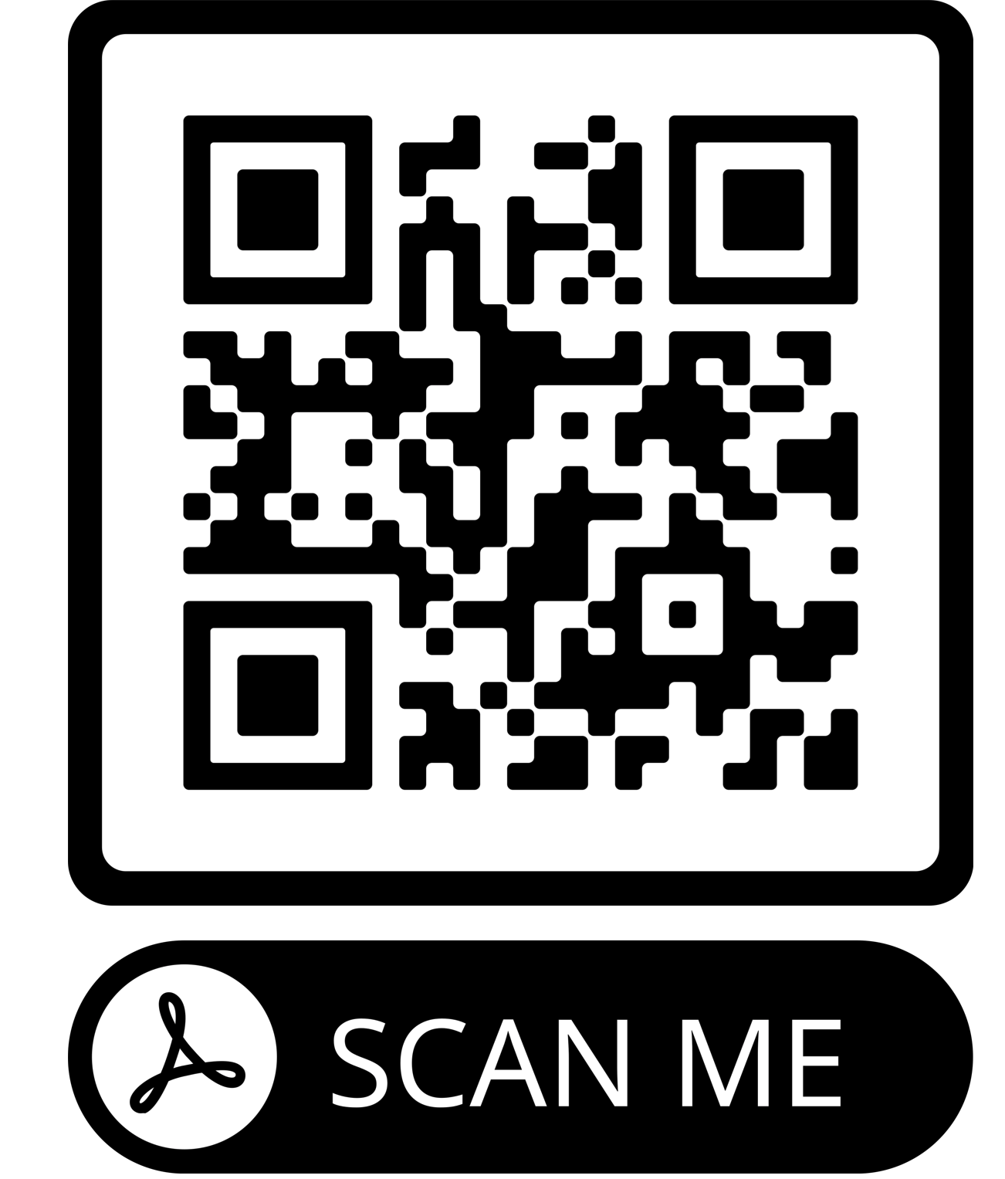
Title: Development of a Clinical Practice Guideline for Management of Stress in Adult Extracorporeal Membrane Oxygenation (ECMO) Patients Author: Shannon B. Hornsby, DNP, ACNP
PROBLEM STATEMENT
ECMO patients are exposed to known PTSD risk factors including inadequate sedation/analgesia, delirium/agitation, profound illness severity, prolonged hospitalization stays, surgical incision scarring (Tramm et al., 2017).
40% of ECMO patients experience significant adverse mental health outcomes specifically acute stress disorder (ASD) and post-traumatic stress disorder (PTSD), contributing to overall worse quality of life post-ECMO (Khan et al., 2020).
If not treated it can precipitate other conditions like substance abuse, depression, memory problems, and suicide (APA, 2013).
There are no current institutional/international guidelines in place to mitigate this problem.
PROJECT PURPOSE
Effectively assess, manage, and reduce ASD/PTSD in ECMO patients.
The overarching aim is to explore current evidence-based practices in managing ASD/PTSD in adult ECMO patients and develop a clinical practice guideline.
PICOT: Based on current evidence, what primary, secondary and tertiary guidelines could be used to manage stress in adult ECMO patients?
MODEL/NURSING THEORY
ACE Star Model of Knowledge Transformation for evidence-based practice
Neuman's Systems Model Nursing Theory
METHODS
• Subjects (Participants)
A clinical practice guideline was created by the DNP student along with the multidisciplinary healthcare team and then evaluated by 8 ECMO key stakeholders (2 cardiothoracic surgeons, 3 critical care physicians, 1 ECMO specialist nurse, 1 ECMO coordinator, and 1 advanced practice practitioner).
Setting
The guideline provides levels of prevention to adult ECMO patients in the CVICU, throughout their hospitalization, and at one year post discharge.
Instruments/Tools
The Johns Hopkins Nursing Evidence-Based Practice (JHNEBP) Research Appraisal Tool (2017) was used to formulate and grade recommendations for the guideline.
The AGREE II tool was used to preform the internal review of the guideline which consists of 23 criteria measured in six domains and appraised on a 7-point scale.
Intervention and Data Collection
The guideline was developed using the Institute of Medicine Standards for Developing Trustworthy Clinical Practice Guidelines. The recommendations are based on 1) strength of evidence; 2) treatment outcomes and the balance of benefits vs. harms and burdens of interventions; 3) patient values and preferences; 4) applicability of the evidence to various treatment populations; 5) risk of bias (IOM, 2011). Stress prevention and serious harm was recognized by the panel as critical points in selecting recommendations. ASD and PTSD identification and treatment, increased quality of life and decreased risk of disability following ECMO therapy were identified as additional factors for choosing recommendations.
SUMMARY OF RECOMMENDATIONS
RESULTS OF AGREE II INTERNAL REVIEW
High quality guidelines are those with scores >70% (red line) in each domain
DISCUSSION
It is important for all ECMO programs to have ongoing quality improvement processes utilizing the best and most updated evidence. With ECMO therapy gaining momentum and mortality outcomes improving, interest is shifting from reduction of mortality, toward evaluation of long-term outcomes and preventing significant morbidities.
Perhaps, the most challenging intervention is preventing stress in the first place by understanding ECMOs effects on sedation/analgesia pharmacokinetics.
The panel realizes that recommendations may change as new evidence emerges, specifically data concerning most appropriate analgesics and sedatives in ECMO patients.
Promising research includes the Antibiotic, Sedative and Analgesic Pharmacokinetics During Extracorporeal Membrane Oxygenation (ASAP ECMO) study and the ECMO PK Project.
IMPLICATIONS FOR ADVANCE PRACTICE NURSING
The Acute Care Nurse Practitioner has a duty to evaluate outcomes across the continuum of health care to meet the specialized physiologic and psychological needs of patients by developing quality improvement projects.
SUSTAINABILITY
This guideline provides a foundation for developing future studies specifically aiming at preventing, reducing, identifying, and treating the stress experience by patients on ECMO.
Future studies include implementation of the guideline and data collection from the Critical Illness Recovery Center.
The guideline will be updating annually using a multidisciplinary approach.
REFERENCES
Primary Prevention
ICU Liberation Bundle (A-F)
Secondary Prevention
Individual trauma-focused psychotherapy (primary component of exposure, cognitive restructuring)
Tertiary Prevention
Identify pre-existing psychiatric history
Careful medication reconciliation for antidepressant, anxiolytics, and antipsychotics
Physiological stress ulcer prophylaxis
CAPS-5 screening tool: 30 days from decannulation and at one year post ECMO
SSRI while hospitalized if DSM-5 criteria met
Nonpharmacologic stress reduction techniques: relaxation, distraction, massage/touch, music therapy, pet therapy
Follow-up consultation to Psychologist or Psychiatrist for patients with emotional symptoms
Implementation of a Critical Illness Recover Center
ECMO survivor support group
Resources upon discharge
Use of “awake” ECMO” when possible.
STRUCTURE & LINE OF DEFENSE
STRESSORS
REACTION
INTERVENTIONS
LEVELS OF PREVENTION
RECONSTITUTION
8 out of 8 key stakeholders recommend this high-quality clinical practice guideline
using primary, secondary and tertiary methods to assess, manage, and reduce
ASD/PTSD in adult ECMO patients.
Notes:
Use Arial font
For text boxes: Do not drop below font size 28, but if you have extra space, you can up the font size until the space is full.
You can move around and customize the template to best fit your information.
Create a QR Code here: https://www.qrcode-monkey.com/ or here: https://www.qr-code-generator.com/

