Slide 1
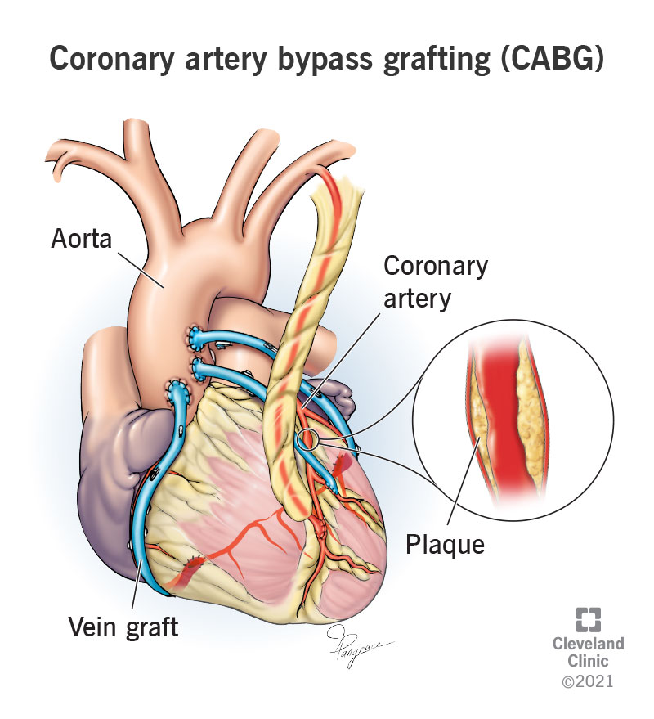
Discharge Optimization Tool to Decrease Length of Stay and Improve Satisfaction Related to Multidisciplinary Communication
Sean Kelly, DNP, APRN, AGACNP-BC
Project Faculty: Christina Cardy, DNP, APRN, AGACNP-BC
PROBLEM STATEMENT
Length of stay (LOS) of patients undergoing isolated coronary artery bypass grafting (CABG) at an urban, level 1 trauma center was 8.7 days, 24% longer than the 7.0-day benchmark set by the Society of Thoracic Surgeons (STS).
No clear verbal or electronic communication protocol from cardiothoracic surgery Advanced Practice Providers (APPs) regarding anticipated discharge time, resulting in decreased communication satisfaction among cardiothoracic surgery APPs
PROJECT PURPOSE
Implement an evidence-based, color-coded Discharge Optimization Tool (DOT) within the Electronic Health Record (EHR) to communicate anticipated discharge time with the multidisciplinary team to decrease LOS and improve cardiothoracic surgery APP communication satisfaction.
CLINICAL QUESTION
In adult patients receiving elective, isolated CABG, does implementation of a DOT reduce hospital LOS and improve APP communication satisfaction over a three-month period when compared to current practice?
MODEL/NURSING THEORY
QI model: Model for Improvement
Practice Theory: The foundation of this theory uses evidence-based research to support a change process to improve patient outcomes.
METHODS
Participants: Adults who received elective, isolated CABG from January-April 2022..
Setting: Cardiothoracic Surgical ICU and cardiac telemetry unit of an urban, level 1 Trauma Center/tertiary referral center.
RESULTS
DISCUSSION
Implementation of the DOT significantly reduced LOS in adult patients receiving isolated CABG from 8.73 days to 7.31 days (p=0.007).
The reduction in LOS resulted in an estimated cost savings of $58,220 over the implementation period.
Integration of a DOT into the EMR is an efficient and effective means of multidisciplinary communication.
DOT compliance was >90% when used in the progress note; DOT utilization within the “Treatment Team Sticky Note” was inconsistent.
DOT noncompliance was most common on postoperative day 2 when the DOT was to be initiated.
APP-led discharge communication can foster discharge efficacy, and improve communication satisfaction
IMPLICATIONS FOR ADVANCED PRACTICE NURSING
APPs play an important role in care coordination, transitions of care, and patient throughput.
Embedding the color-coded DOT within the EHR could expand opportunities for better visualization and accessibility
Using the EHR to facilitate discharge communication enhances multidisciplinary communication, communication satisfaction, and discharge timeliness.
SUSTAINABILITY
The DOT is concise, easy to interpret, and required little to no training among cardiothoracic surgery APPs.
Integrating the DOT into the initial progress note template for use on postoperative day zero could improve DOT compliance and facilitate sustainability.
The DOT is not specific to cardiothoracic surgery, and therefore could easily be adopted by other medical or surgical healthcare teams or health systems.
Postoperative LOS was reduced 16% from 8.73 days to 7.31 days (p=0.007)
Communication satisfaction among cardiothoracic surgery APPs improved by 33%
Instruments/Tools
Discharge Optimization Tool
Discharge status: Green (Anticipated discharge is < 12 hours)
Discharge status: Yellow (Anticipated discharge is 12-24 hours)
Discharge status: Red (Anticipated discharge is 24-48 hours)
Discharge Status: Black (Anticipated discharge is not anticipated at this time)
A validated Communication Satisfaction Questionnaire (CSQ) used to assess cardiothoracic APP communication satisfaction pre- and post-implementation
Intervention and Data Collection
Educated key stakeholders on problem significance.
Evaluated baseline communication satisfaction of cardiothoracic APPs.
Obtained baseline LOS data.
Implemented the DOT within the progress note disposition and “Treatment Team Sticky Note” of the EHR to communicate the discharge time-frame with each patient’s multidisciplinary team.
Statistically analyzed data using one sample T-test.
Appraised post-intervention mean CSQ scores among cardiothoracic APPs.
Evaluated post intervention communication satisfaction.
REFERENCES:
The use of a DOT to communicate the anticipated time to discharge with the multidisciplinary team significantly decreased postoperative LOS in patients undergoing isolated CABG, and improved cardiothoracic surgery APP communication satisfaction.
Notes:
Use Arial font
For text boxes: Do not drop below font size 28, but if you have extra space, you can up the font size until the space is full.
You can move around and customize the template to best fit your information.
Create a QR Code here: https://www.qrcode-monkey.com/ or here: https://www.qr-code-generator.com/

