Slide 1
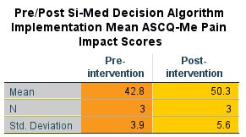
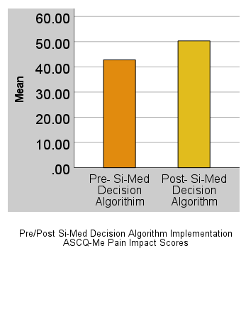
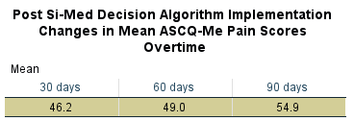
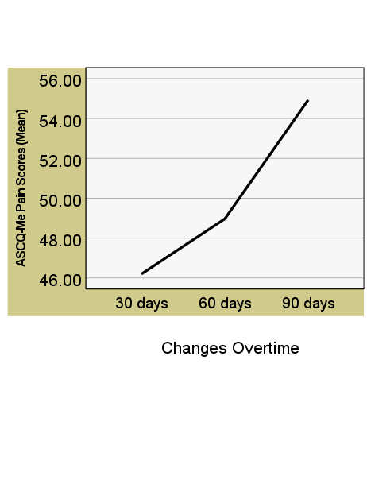
IMPLEMENTATION OF A SICKLE CELL DISEASE MANAGEMENT ALGORITHM FOR OPTIMIZING DISEASE-MODIFYING DRUG THERAPIES
Eva Okereke-Enechukwu, MD, DNP, APRN, FNP-BC
Project Faculty: Elizabeth Remo, DNP, APRN, FNP-BC
PROBLEM STATEMENT
Pain has a profound impact on the lives of sickle cell disease (SCD) patients, and the true burden is likely underestimated because patients prefer to treat their pain at home rather than going to the hospital or emergency room (Rizio et al., 2020)
Since there is no cure for these patients' conditions, they must accept the status quo until treatment improves
PROJECT PURPOSE
Examine the effectiveness of the evidence-based SCD management algorithm, titled Si-Med (Sickle cell-Medication) Decision Algorithm, in reducing the severity of SCD-related pain, ultimately improving the patient's daily functioning
Clinical Question: In patients,18 years and older who have SCD and experience SCD-related pain greater than two days a week, does implementing an SCD management algorithm reduce the severity of SCD-related pain when compared to current practice, in an outpatient hematology clinic, within 90-days?
METHODS
Participants
Inclusion criteria: 18 years and older, diagnosed with SCD, experiencing greater than two days a week of SCD-related pain, new or established patients not receiving, responding, or tolerating Antimetabolite urea derivatives therapy
Exclusion criteria: Diagnosed with sickle cell trait, receiving any of the newly FDA-approved SCD-modifying medications alone or in combination with Antimetabolites, or refusing disease-modifying therapies
Sampling Method: Non-probability (used purposive and convenient sampling technique)
Setting
Outpatient hematology clinic/sickle cell center located in Tampa, Florida
RESULTS
DISCUSSION
Enrolled five SCD patients
Two patients were lost to follow up
Remaining three patients were assessed post-implementation
Patients were already on the Antimetabolite, urea derivatives (Hydroxyurea) for over one year with suboptimal responses. Therapy was intensified by adding the L-Glutamine (Endari) to the patients’ treatment regimen according to the Si-Med Decision Algorithm.
The ASCQ-Me pain impact short form was scored following the developer's guidelines and converted to T-scores
T-scores are standardized to have a Mean of 50 (indicates an average health score on the scale) and a Standard Deviation of 10 (represents one SD). Higher scores for the pain impact domain represent a more favorable status (Keller et al., 2017)
Implementation of the Si-Med Decision Algorithm did not yield a statistically significant result due to the minimal sample size. Still, it was clinically significant because the higher ASCQ-Me mean pain score (17.52% increase from baseline) represented a more desirable outcome (reduction in the severity of SCD-related pain) for the patient-participants
LIMITATIONS
Sampling Method
Low recruitment/Small sample size
Failure to follow up
Attrition
IMPLICATIONS FOR ADVANCED PRACTICE NURSING
The use of treatment strategies such as the Si-Med Decision Algorithm can serve as a cognitive aid and decision support to help providers enhance care delivery in treating SCD patients
SUSTAINABILITY
Outpatient hematology and comprehensive sickle cell disease centers exist across the country
Collaborate and coordinate the use of the Si-Med Decision Algorithm across centers in managing SCD patients
Introducing and encouraging the use of the Si-Med Decision Algorithm in the primary care setting among primary care providers to improve patient outcomes
REFERENCES
Instruments/Tools
Adult Sickle Cell Quality of Life Measurement Information System (ASCQ-Me) Pain Impact Domain Short Form (Paper format)
Assesses the severity of SCD-related pain and its impact on daily functioning
Intervention and Data Collection
Conducted over four months, from January 2022 to May 2022
Chart review of established patients, assessment of newly encountered SCD patients, medication reconciliation, and pre-intervention assessment using ASCQ-Me pain impact short form over one month
SCD management algorithm (Si-Med Decision Algorithm) implemented
Post-intervention assessment using ASCQ-Me pain impact short form, weekly via phone calls to the patient-participants during the remaining three-month project period
Figure 3: Si-Med Decision Algorithm
MODEL/NURSING THEORY
Quality Improvement model
Figure 1: The Quality Health Outcomes Model (Moore, 2015)
Nursing Theory
Figure 2: Kolcaba’s Comfort Theory (Kolcaba, 2018)
The use of the Si-Med Decision Algorithm is effective and feasible for the management of patients with sickle cell disease.
Notes:
Use Arial font
For text boxes: Do not drop below font size 28, but if you have extra space, you can up the font size until the space is full.
You can move around and customize the template to best fit your information.
Create a QR Code here: https://www.qrcode-monkey.com/ or here: https://www.qr-code-generator.com/

