Slide 1
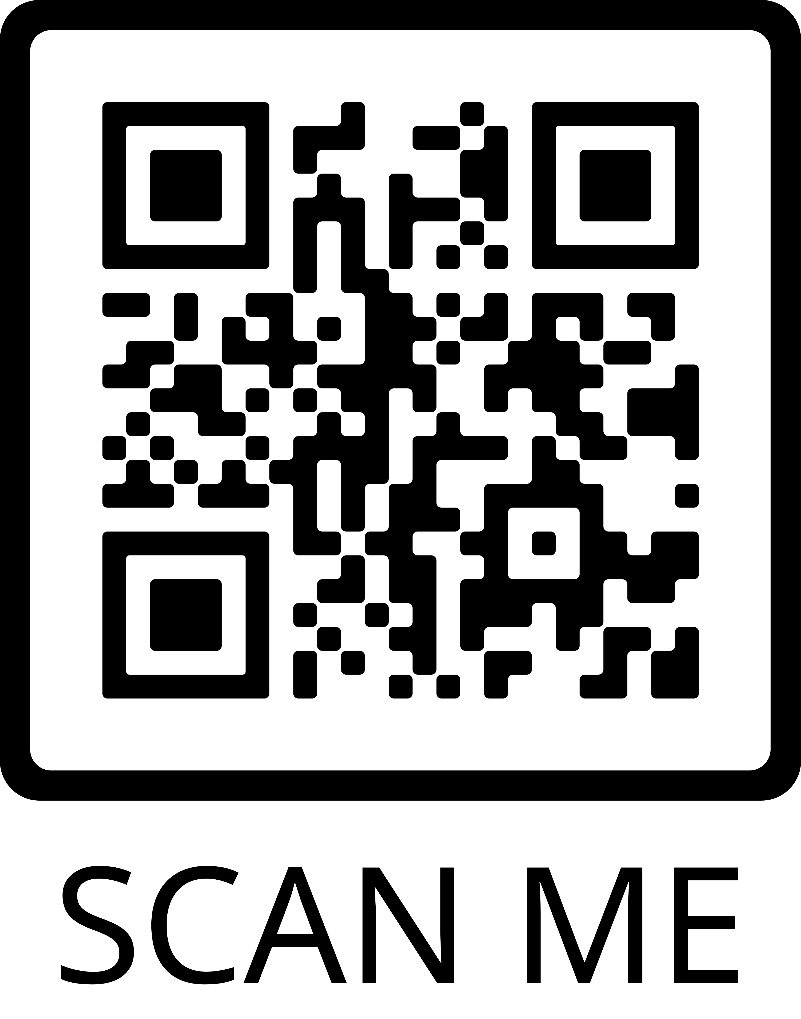
Engaging Parents of School Age Children in a Digital Health Enhanced Lifestyle Program
Lauren Ramos, DNP, APRN, CPNP-PC
Project Faculty: Sharlene Smith, DNP, APRN, CPNP-AC/PC
PROBLEM STATEMENT
Parental involvement is important to child lifestyle change
13.4% of 2-5 year-olds and 20.3% of 6-11-year-old obese in U.S. (CDC, 2021)
28.5% of Women, Infant, and Children (WIC) aged children 2 years and older in Hillsborough County were overweight or obese in 2020 (Florida Department of Health, 2021)
PROJECT PURPOSE
↑ parental confidence in family lifestyle change through engagement with text messages
Aim: ↑ parental self-efficacy (PSE) questionnaire score 20% over 12 weeks
PICO QUESTION
In a population of children aged five to nine-years old participating in a nutrition and physical activity program, does provider-parent engagement through text messaging over a three-month period increase PSE compared to current engagement with parents?
MODEL/NURSING THEORY
IHI QI model (Institute for Healthcare Improvement, 2021)
Albert Bandura’s Social Cognitive Theory- focuses on interplay between people’s thoughts, behaviors, and motivation
METHODS
Participants
Instruments/Tools
PSE score measured with Parental Self-Efficacy Questionnaire (Decker, 2012)
34 item Likert-scale questionnaire
Focuses on parent confidence in children’s nutrition and physical activity behaviors
Intervention and Data Collection
Parents completed initial survey at first in-person session
All parents chose to receive text messages
Parents received 1-3 text messages/week for 12 weeks
Parents completed survey 2 at 6th and final in-person session or via Microsoft Forms
Parents were emailed survey 3 via Microsoft Forms
Deidentified data was analyzed
RESULTS
-Mean initial PSE score: 193.3
-Two participants completed the second survey with scores of 177 and 257
-Two participants completed the third survey with scores of 177 and 302
-Scores increased from survey 1 to survey 2 and from survey 1 to survey 3
-One participant’s score increased from survey 1 to survey 2 but did not change from survey 2 to survey 3
DISCUSSION
4 parents of 326 children participated in all 6 sessions of a DOH lifestyle program in 2019-2020
More studies needed to determine if text messaging is effective way to ↑ PSE related to child health behaviors
Limitations: attrition high in this project with 1 parent-child dyad completing all 6 sessions
Possible reasons for attrition include high gas prices, hesitation to attend in-person due to COVID-19, language barriers, and poor understanding of content of the program
IMPLICATIONS FOR ADVANCE PRACTICE NURSING
Text messaging parents of pediatric patients has potential to help engage parents in making lifestyle changes as a family
SUSTAINABILITY
Existing text messaging platform continues to be used to send reminders and health tips to parents
Facilitator need only add parent phone numbers after obtaining consent
REFERENCES
Demographic Characteristics
Variable | Total n (%)
Gender of parent
Male | 3 (42.9)
Female | 4(57.1)
Age of children (years), mean | 6.7
Race of parent
Caucasian | 2 (29)
Asian | 1(14)
Other | 1(14)
N/A | 3(43)
Age of parent, mean | 41
Mean Survey Scores
Survey 1 score, mean (n=7) | 193.3
Survey 2 score, mean (n=2) | 305.5
Survey 3 scores (n=2) | 328
Text messaging parents of pediatric patients may be a promising way to
increase parental self-efficacy related to child behavior change.
Notes:
Use Arial font
For text boxes: Do not drop below font size 28, but if you have extra space, you can up the font size until the space is full.
You can move around and customize the template to best fit your information.
Create a QR Code here: https://www.qrcode-monkey.com/ or here: https://www.qr-code-generator.com/
Did not perform a Wilcoxin Sign Rank test because low power, and cannot give a statistically significant result with less than 5 pairs

