Slide 1
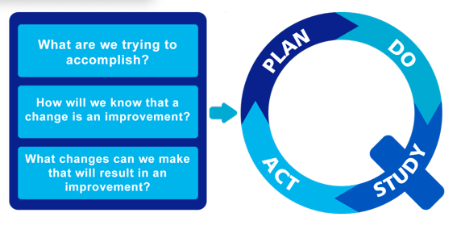
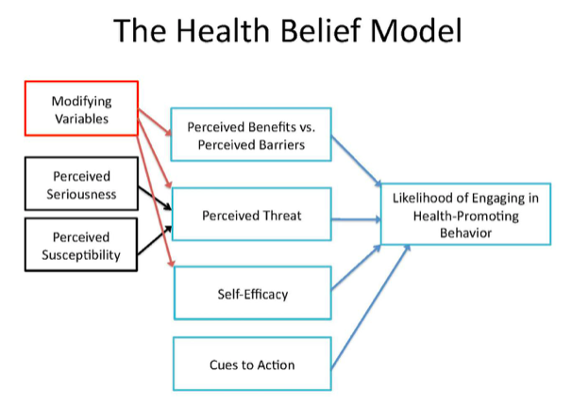
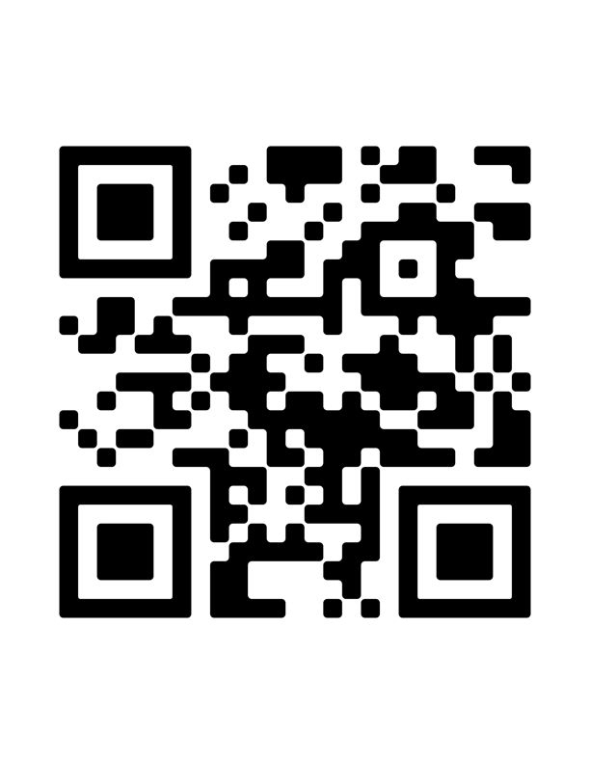
Program Implementation for Hypertension Control in the Primary Care Setting Author: Julie Starr, DNP, APRN, AGPCNP-BC
Project Faculty: Carmen Rodriguez, PhD, APRN, ANP-BC, AOCN
Problem Statement
Model/Nursing Theory
Results
Discussion
Providers at a primary care practice identified 95% patients had uncontrolled hypertension (HTN) as evidenced by Medicare’s Merit-based Incentive Payment System Quality improvement (MIPS QI) report.
Overall purpose: implement the Partner with Patients Target: Blood Pressure (PPT:BP) program as a standardized approach to manage HTN in a primary care outpatient clinic.
Overarching aim: evaluate if the PPT:BP program had an impact on HTN control
Primary outcomes: BP and body mass index (BMI) reduction
Secondary outcomes: MIPS QI report HTN percentage decrease
In primary care outpatients, age 18-59, with
uncontrolled HTN does the implementation
of the Partner with Patients Target: BP
program, in comparison with the usual
unstructured care, result in a decrease in
BP, BMI, and a MIPS QI report of 50% of
patients satisfying criteria, after 90 days of
implementation.
DNP led PPT:BP program was feasible in a primary care setting.
A trend towards BP improvement was identified over 3 months.
Longer periods of participation in the program may be necessary to assess for the impact on BMI.
Providing continuity to a structured HTN control program
determine the long-term impact on the MIPS-QI report.
Increase number of participants and long-term follow up
Integrate other healthcare staff as collaborators
Findings demonstrate the PPT:BP program has the potential to improve HTN control.
The project impacted the way care was implemented, encouraging patients to play a more active role in their treatment plan.
Sustainability: time commitment and coordination is of essence to provide patients access to educational material, follow-up and monitoring beyond usual care in the primary care setting.
 | Model for improvement Use to aid in planning and execution Defined what project would accomplish Plan-Do-Study-Act Decrease BP and BMI (aim 1) Decrease MIPS QI (aim 2) Incorporate PPT:BP Observe effects to determine success
 | The Health Belief Model Framework project grounded by Guide health promotion and prevention Emphasized importance of patient education Postulates patients not motivated to act unless: Believe severe threat to health Treatment will lead to positive outcome
Pre-SBP (M=148.67, SD=9.59)
Post-SBP (M=124.74, SD=9.43) p=0.0001
Project Purpose
Implications for Advanced Nursing/Sustainability
Methods
Pre-DBP (M=96.08, SD=5.73); post-DBP (M=79.17, SD=9.96) p=0.0001
Setting: Outpatient primary care practice | Outpatient primary care practice
Participants | Active patients aged 18-59, with HTN 12 participants: 5 female, 7 male
Measures | BP BMI MIPS QI report
Procedures In-service prior to project start date Initial MIPS QI report run Patients identified with HTN completion of HSCALE questionnaire PPT:BP education Data collection: BP and BMI Follow-up phone call 3 weeks after initial visit to reinforce teachings Final project visit 3 weeks after phone call Data collection: BP and BMI Final MIPS report run Pre/post intervention data analysis
PICOT Question
41.7% reduction of BMI, 8.3% increase
MIPS Pre- QI report
MIPS Post- QI report
References
A structured HTN treatment program, such as the PPT:BP, can be a powerful tool to promote improvement in HTN management in the primary care setting, leading to positive patient health outcomes.
Notes:
Use Arial font
For text boxes: Do not drop below font size 28, but if you have extra space, you can up the font size until the space is full.
You can move around and customize the template to best fit your information.
Create a QR Code here: https://www.qrcode-monkey.com/ or here: https://www.qr-code-generator.com/

