Slide 1
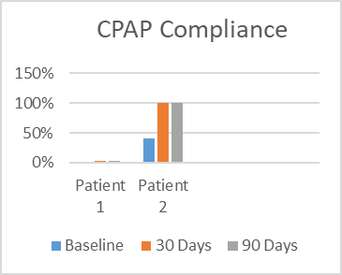
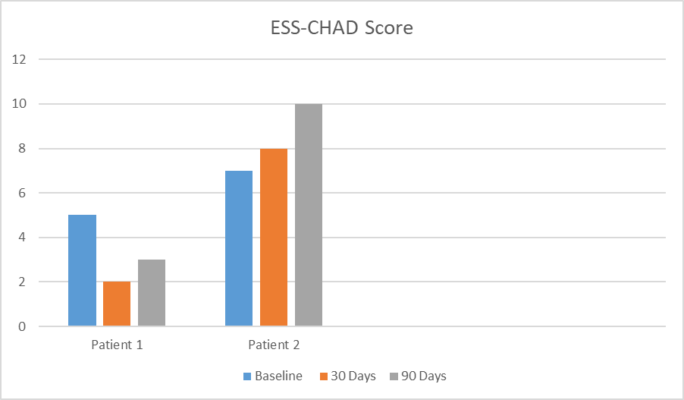
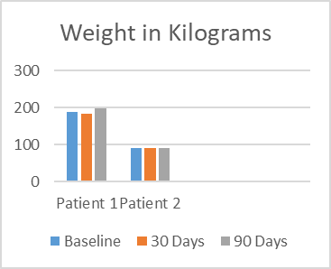
Cathryn Winslow, DNP, APRN, CPNP-PC
Project Faculty: Sharlene Smith, DNP, APRN, CPNP-PC/AC
PROBLEM STATEMENT
There is low CPAP compliance in a pediatric sleep medicine clinic in southwest Florida
Several adolescent patients report they have low compliance rates due to forgetting to wear their CPAP
Only 33% of adolescent patients with obesity and OSA are compliant on CPAP at this clinic
PROJECT PURPOSE
To implement a change in the current workflow of this clinic in order to help increase patients’ compliance on CPAP by sending EMR reminder messages
Determine whether the implementation of EMR reminder messages improves
1) Patients’ CPAP compliance
2) Epworth Sleepiness Scale (Child and Adolescent Version) score
3) Weight loss
Clinical Question: In adolescents ages 13-21 with BMI greater than the 95th percentile, who are on CPAP therapy for obstructive sleep apnea, does automated EMR message reminders sent twice weekly improve adherence to CPAP therapy over 90 days?
METHODS
Participants
Patients ages 13-21 with obesity who are currently non compliant on CPAP treatment or starting CPAP
Patients with a BMI greater than the 95th percentile
Exclusion criteria: Apnea Hypopnea Index (AHI) less than 1, BMI less than 95th percentile, age less than 13 or greater than 21
Setting
Outpatient specialty clinic at a large academic health center
RESULTS
DISCUSSION
Implementation of EMR CPAP reminder messages did not show a statistically significant increase in compliance score (p=0.5676 30 days, p=0.5687 90 days)
Secondary outcome: Implementation of EMR CPAP reminder messages did not show a statistically significant decrease in weight loss (p= 0.9527 30 days, p= 0.9369 90 days)
Secondary outcome: Implementation of EMR CPAP reminder messages did not show a statistically significant decrease in ESS-CHAD score (p= 0.6985, p= 0.8639 90 days)
Results of this project indicate that due to the small number of participants results are not statistically significant and further evaluation with a larger population is needed
IMPLICATIONS FOR ADVANCED PRACTICE NURSING
Untreated OSA in adolescent patients can lead to serious health risks in adulthood such as cardiomyopathy, hypertension, and metabolic disease
Treating OSA in adolescence can help improve health outcomes later in life and is extremely important in preventative health
The implementation of a new work flow allows for more team based care within the department of sleep medicine as well as bariatric surgery
SUSTAINABILITY
Clinic staff has learned how to send reminder messages to patients on CPAP to help continue this project in the future
Retrospective chart review has identified several patients struggling with CPAP
Sleep medicine and bariatrics now share more communication regarding mutual patients and continuous evaluation of work flow
REFERENCES
Instruments/Tools
Smartcard Compliance to measure CPAP compliance and Apnea Hypopnea Index
Epworth Sleepiness Scale Child and Adolescent Version to measure Hypersomnolence
Intervention and Data Collection
Retrospective chart review of all pediatric sleep medicine patients seen in 2020 and 2021 prior to project implementation
Data/Outcomes measured: CPAP compliance at baseline, 30, and 90 days
Secondary outcome: ESS-CHAD score and weight in kilograms at baseline, 30, and 90 days
Development of a change in work flow by sending EMR reminder messages to wear CPAP two days each week for 90 days
Patients had telehealth check in visits at baseline, 30, and 90 days to measure CPAP compliance, weight loss, and ESS-CHAD score
MODEL/NURSING THEORY
Quality Improvement Model
Health Belief Model
Relationship between perceived threat of a disease versus effectiveness of a certain health behavior
Improving CPAP compliance in adolescent patients with OSA
Notes:
Use Arial font
For text boxes: Do not drop below font size 28, but if you have extra space, you can up the font size until the space is full.
You can move around and customize the template to best fit your information.
Create a QR Code here: https://www.qrcode-monkey.com/ or here: https://www.qr-code-generator.com/

